Slide 1

Mrs Pidcock 3R

Slide 2

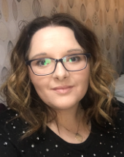
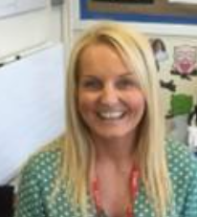

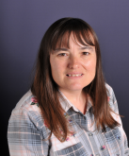
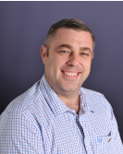
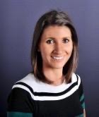
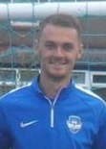
Mrs Pidcock
Class Teacher
Mrs Beetham
Class TA
Mrs Langfield
Music Teacher
Forest School Teacher
Mr Moran
Forest School Teacher
Mrs Tipton
Computing Teacher
Mr Pidcock
PE Teacher

Slide 3


School gates open 8:45am
School starts at 8:50am prompt
Break time 10:30-10:45am
Year 3/4 lunch 11:45-12:25pm
Year 5/6 lunch 12:25-1:15pm
School finishes at 3:20pm

Slide 4
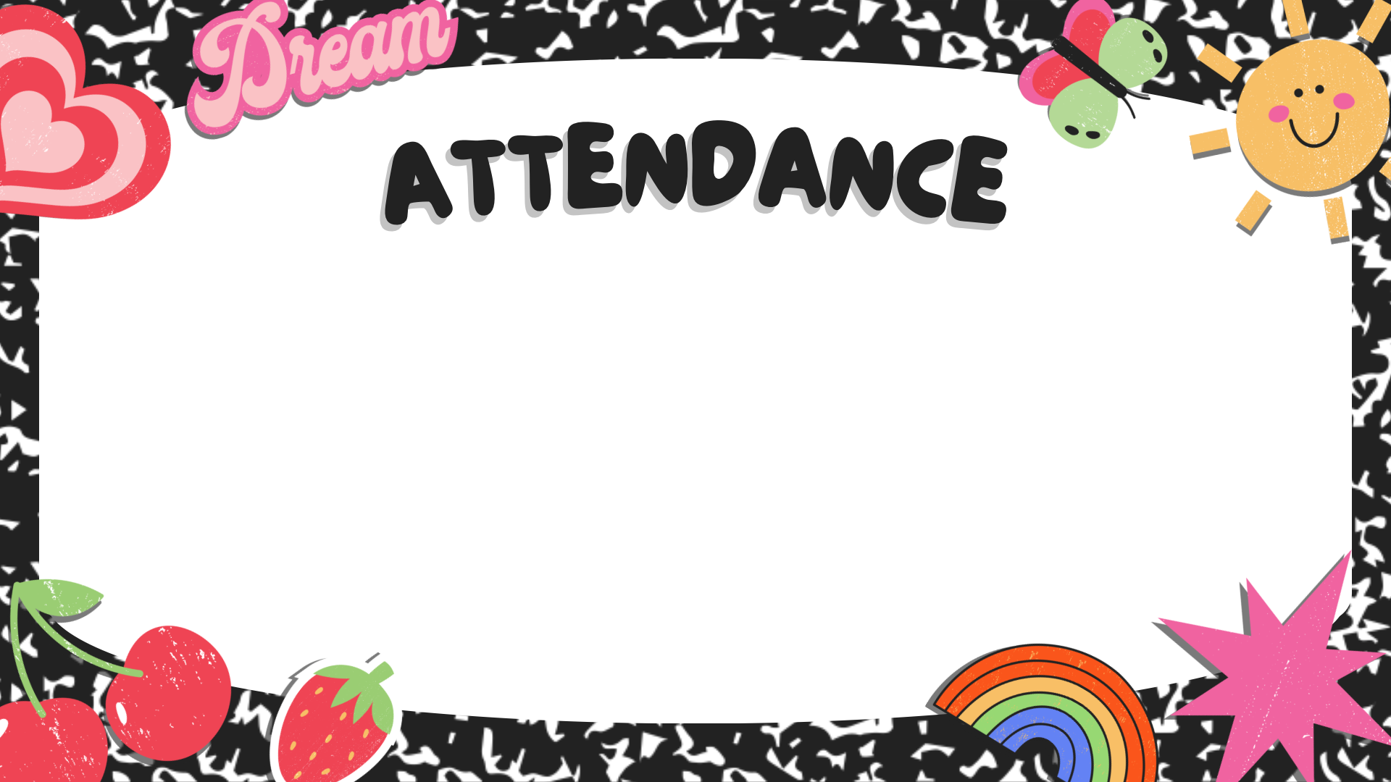

Daily attendance at school is extremely important. It is a parent’s legal responsibility to ensure children are in school every day and on time.
If your child is too unwell to attend school, please ring the school office by 8.30am that day or leave a message on the absence line.
If children drop below 97% attendance(including lates), attendance monitoring will be triggered.
School can not authorise any holidays. If leave is required, an absence form will need to be completed.
Please note if more than 10 sessions ( 5 days) over a 10 week period are taken as unauthorised absences or lates a penalty may be issued by LCC

Slide 5

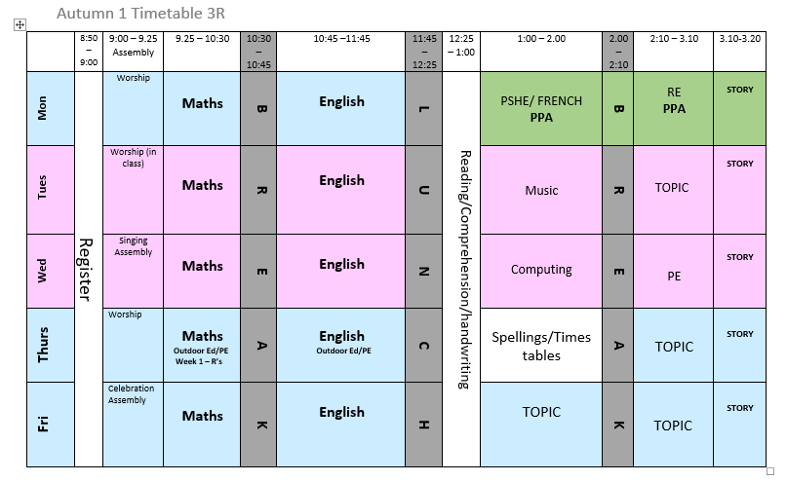

Slide 6

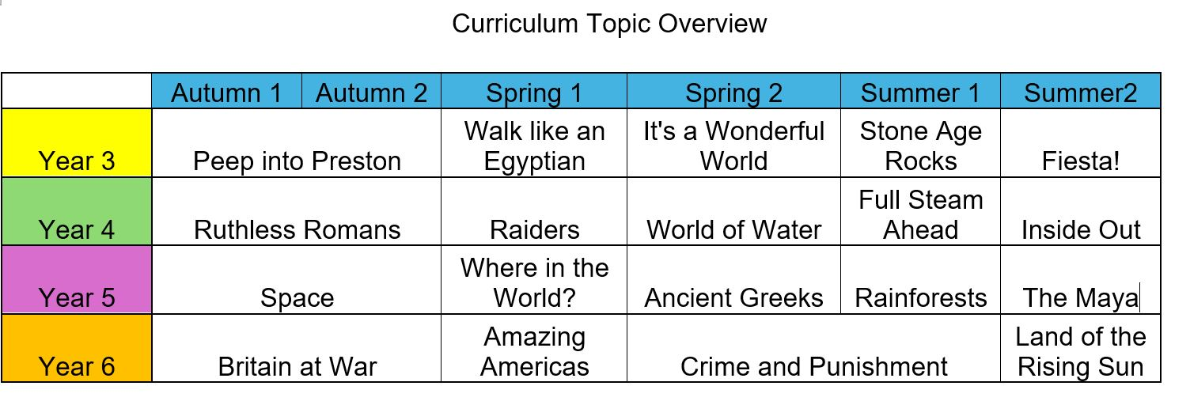

Slide 7

Children should read daily for around 10-20 minutes and record in their reading record
Homework goes home on Friday to be returned on Wednesday
Children will be sent home weekly maths, spellings and SPaG

Slide 8

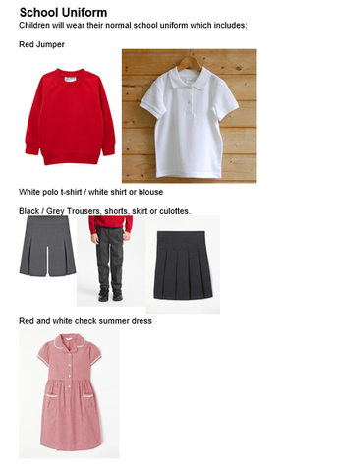
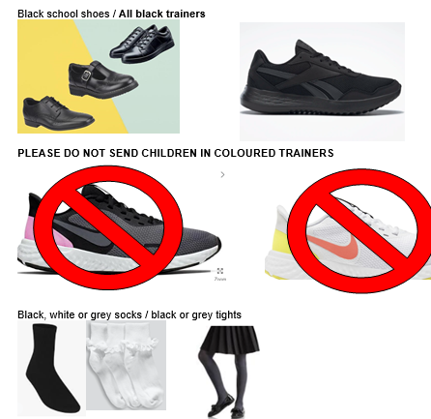
Labelled School uniform must be worn every day:
Red jumper
White shirt/polo
Grey/black white socks or tights
Grey/black skirt/shorts/pants
Black shoes or all black trainers

Slide 9

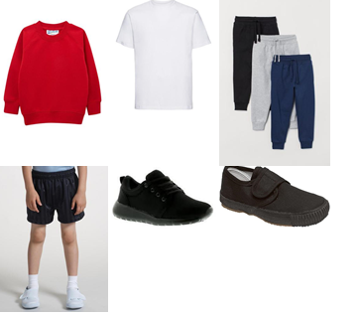
PE days will be on Wednesday
Labelled PE kits should be left in school
This includes:
White T-shirt
Joggers or shorts
All Black trainers or pumps

Slide 10

Outdoor learning will be on a Thursday
On Outdoor Learning days please send your child in clothes that are suitable for being outside and that can get dirty. They will be exploring nature, cooking over open fires, planting and growing things so their clothing needs to be warm, sensible and suitable for a morning outside.
They would benefit from having a pair of wellies and a water proof coat, especially in the winter months

Slide 11


Slide 12


