Slide 1

Welcome to Year 3

Slide 2
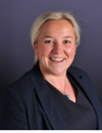
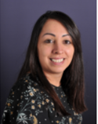
Who’s Who?
Mrs Nickson
Headteacher
Mrs Bleasdale
Deputy
Headteacher

Slide 3
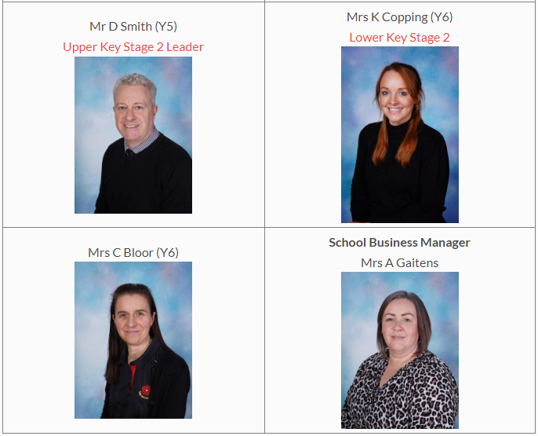
S
L
T

Slide 4
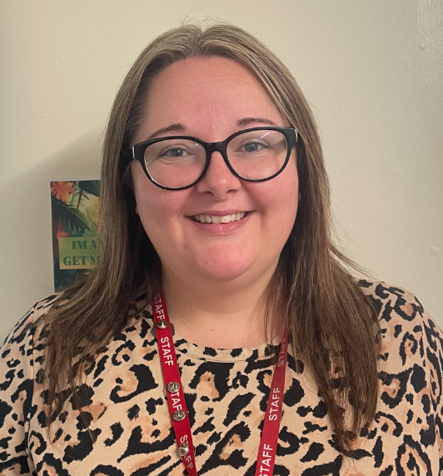
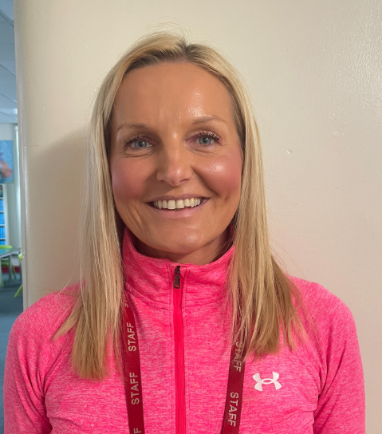
3R Team
Mrs Pidcock
Class Teacher
Mrs Beetham
Class TA

Slide 5
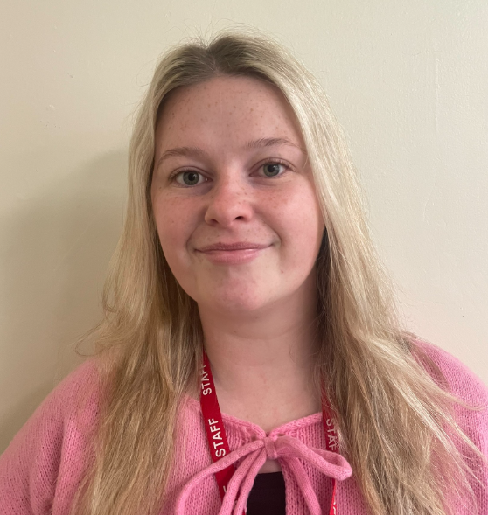
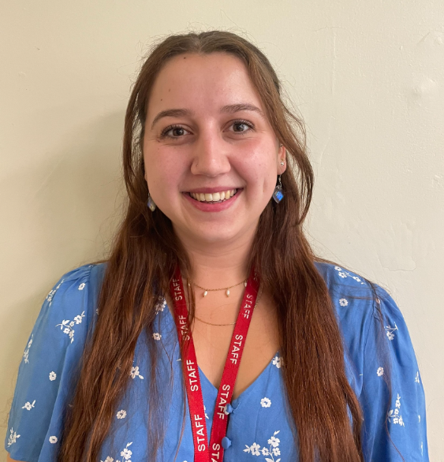
3M Team
Miss Parkinson
Class Teacher
Miss Harty
Class TA

Slide 6
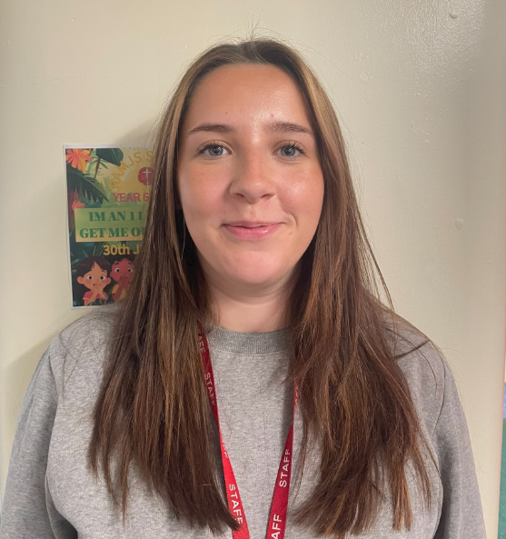
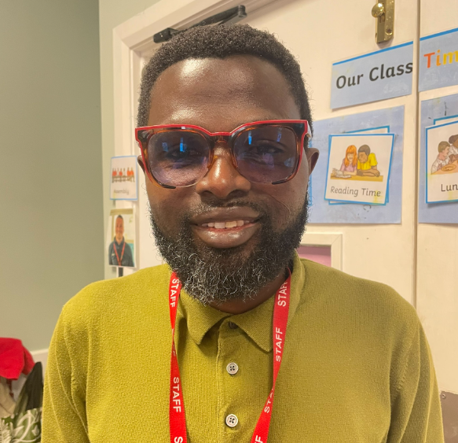
Year 3 Teaching Assistants
Miss Gaitens
Year 3 SEND TA
Mr Agyeman
Year 3 SEND TA

Slide 7
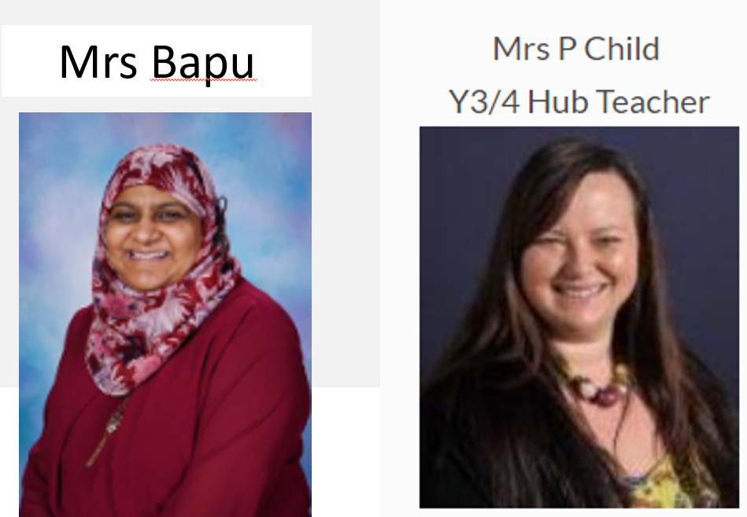
Nest Team

Slide 8
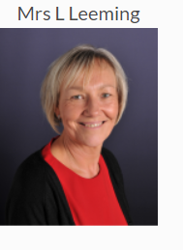
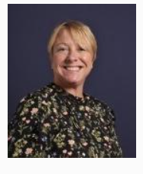
Heart Room
Mrs Tugwell

Slide 9
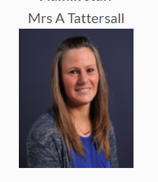
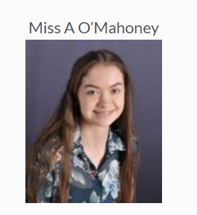
Office Staff

Slide 10
School Day
* School gates open at 8:40am
*School starts at 8:50am prompt
*Break Time- 10.30am-10.45am
*Lunch Time- 11.45am -12.35pm
*School finishes at 3:20pm

Slide 11
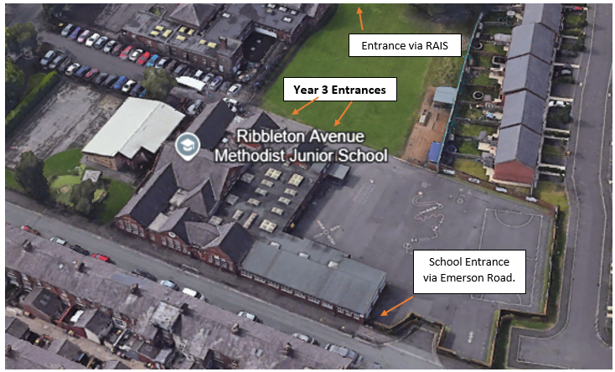
Drop off and Collection points:

Slide 12
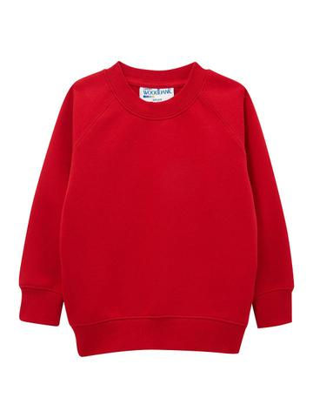
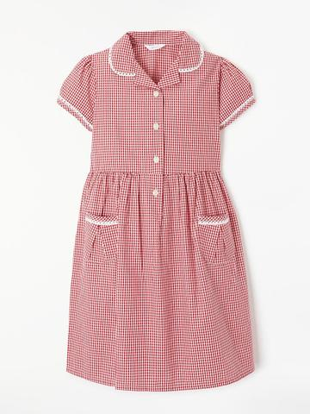
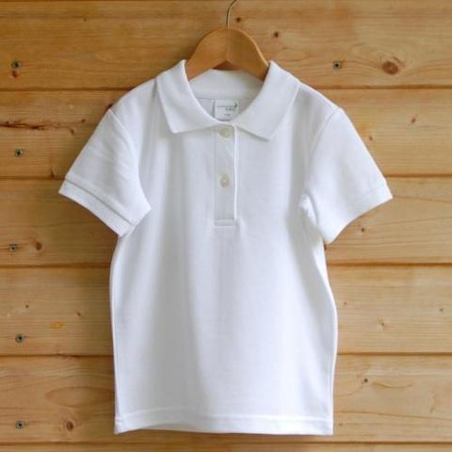
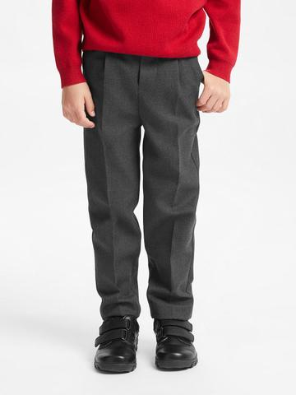
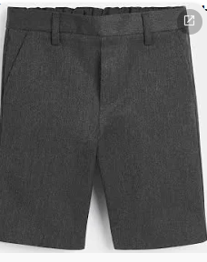
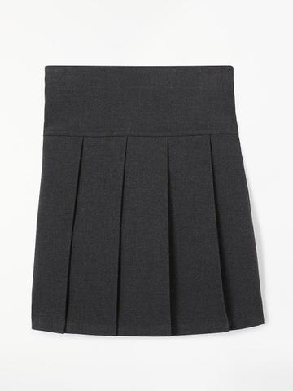

School Uniform

Slide 13
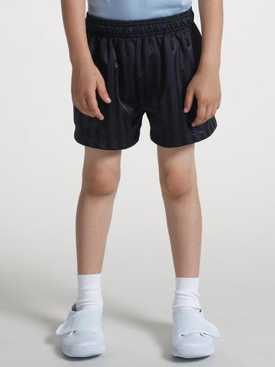

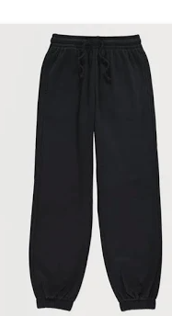
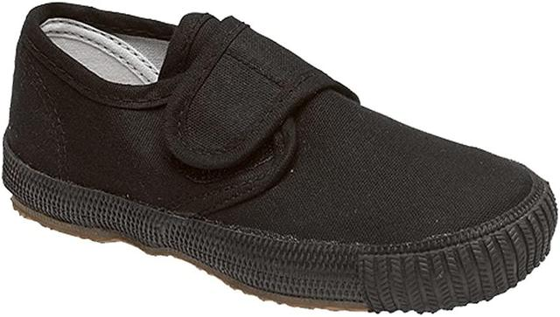
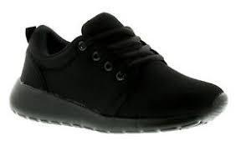
PE KIT

Slide 14



Curriculum
*Broad and varied curriculum

Slide 15
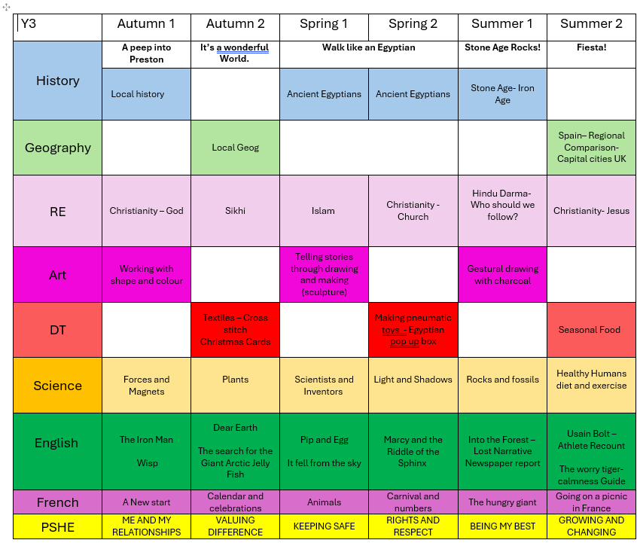

Slide 16

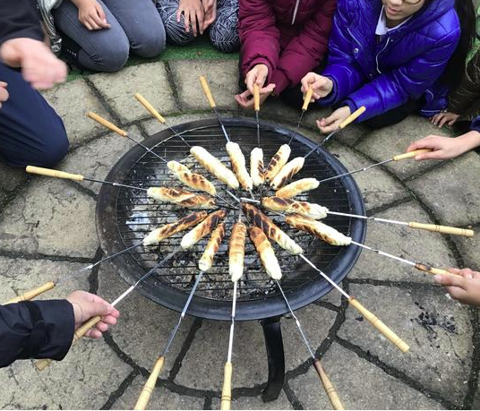
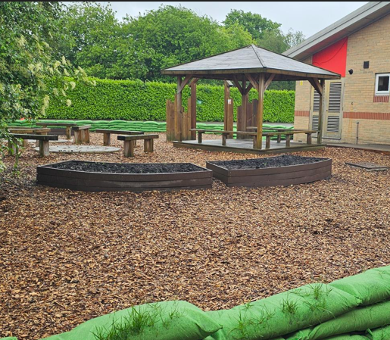
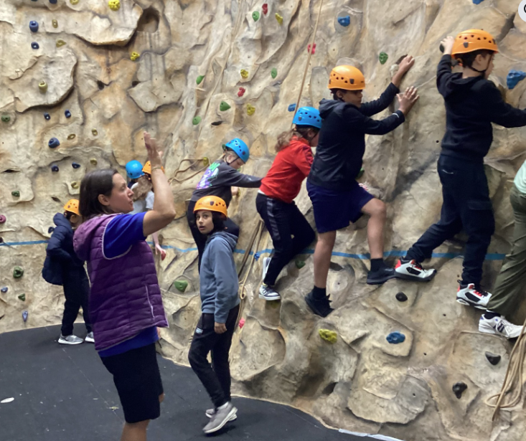
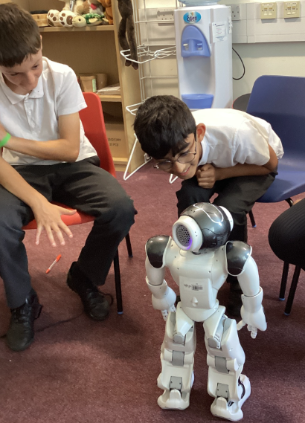
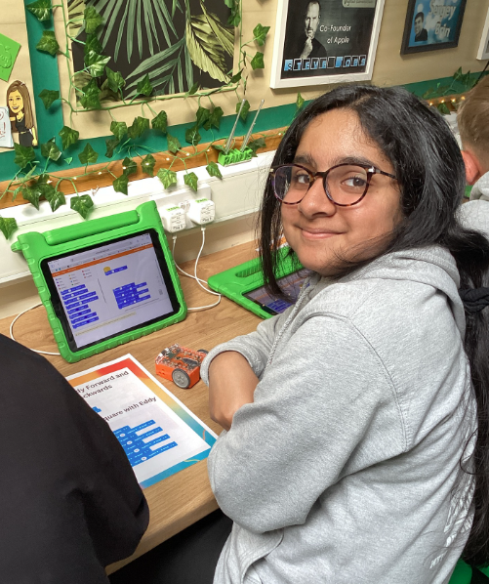
Curriculum Enhancement

Slide 17

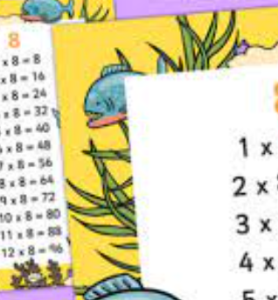
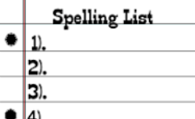
Homework and Reading
Weekly homework is given
Reading every night
Spellings sent home, tested weekly
Timestables pracised each week.

Slide 18
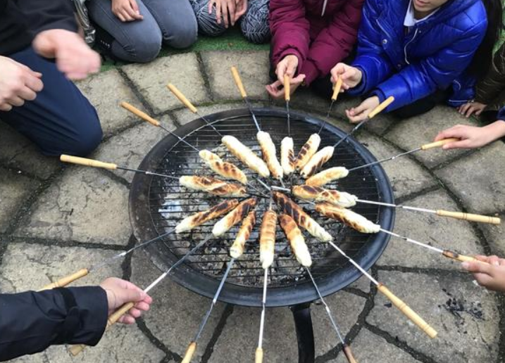
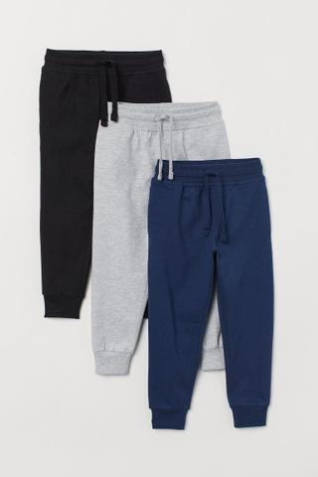


Outdoor Learning

Slide 19

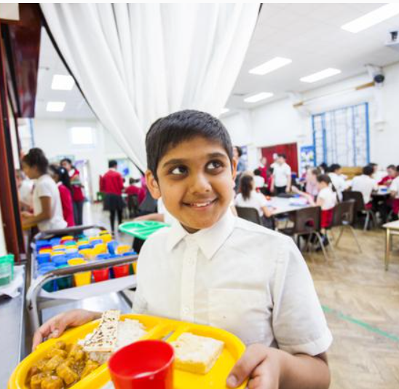
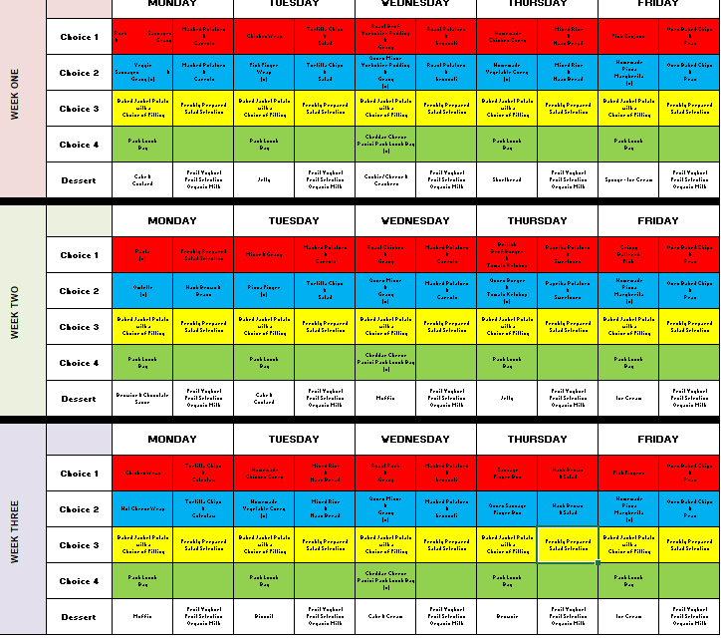
Lunches and
free school meals

Slide 20
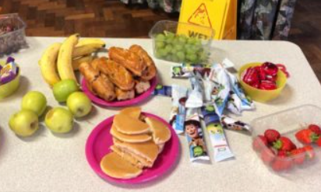
Breakfast Club
Free for all pupils
Starts at 8am
Excellent range of fresh fruit, cereal and toast.

Slide 21

After School Clubs
Run daily until 4.15
Cost £5 for the half term
Run by staff after school or during lunchtimes

Slide 22


