Slide 1
Random Acts of Kindness

Slide 2
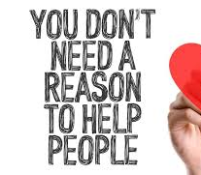
A random act of kindness is doing something without expecting a reward, for no reason at all, just to make someone else feel better!

Slide 3
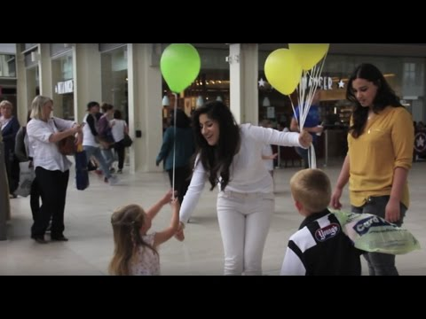

Slide 4
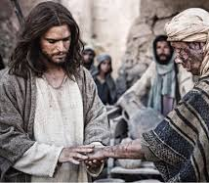
What does the bible say?
Matthew 8:1-4

Slide 5
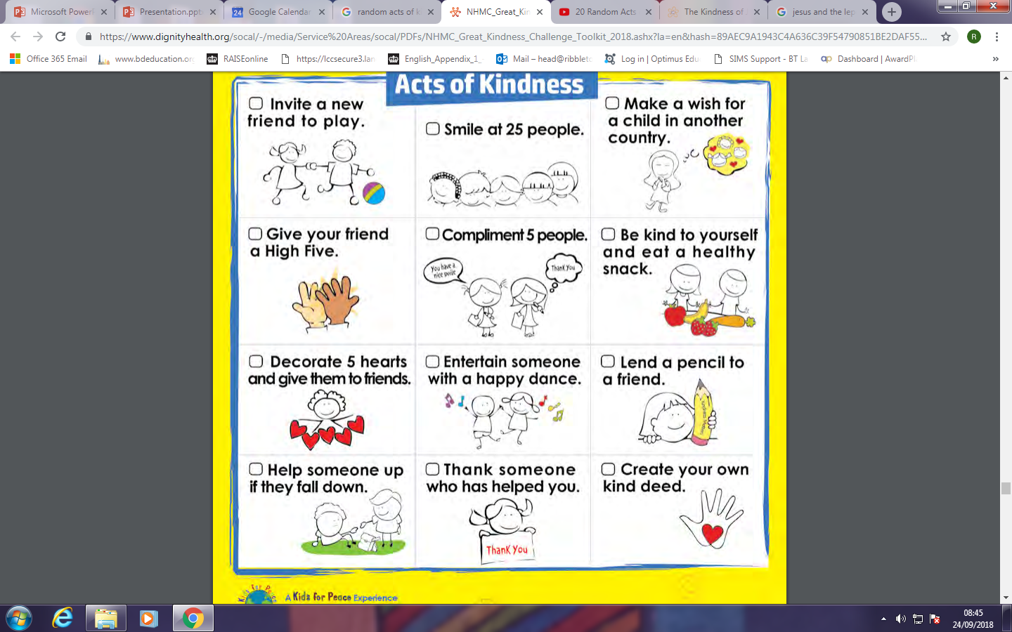
What random act of kindness could you do?

