Slide 1
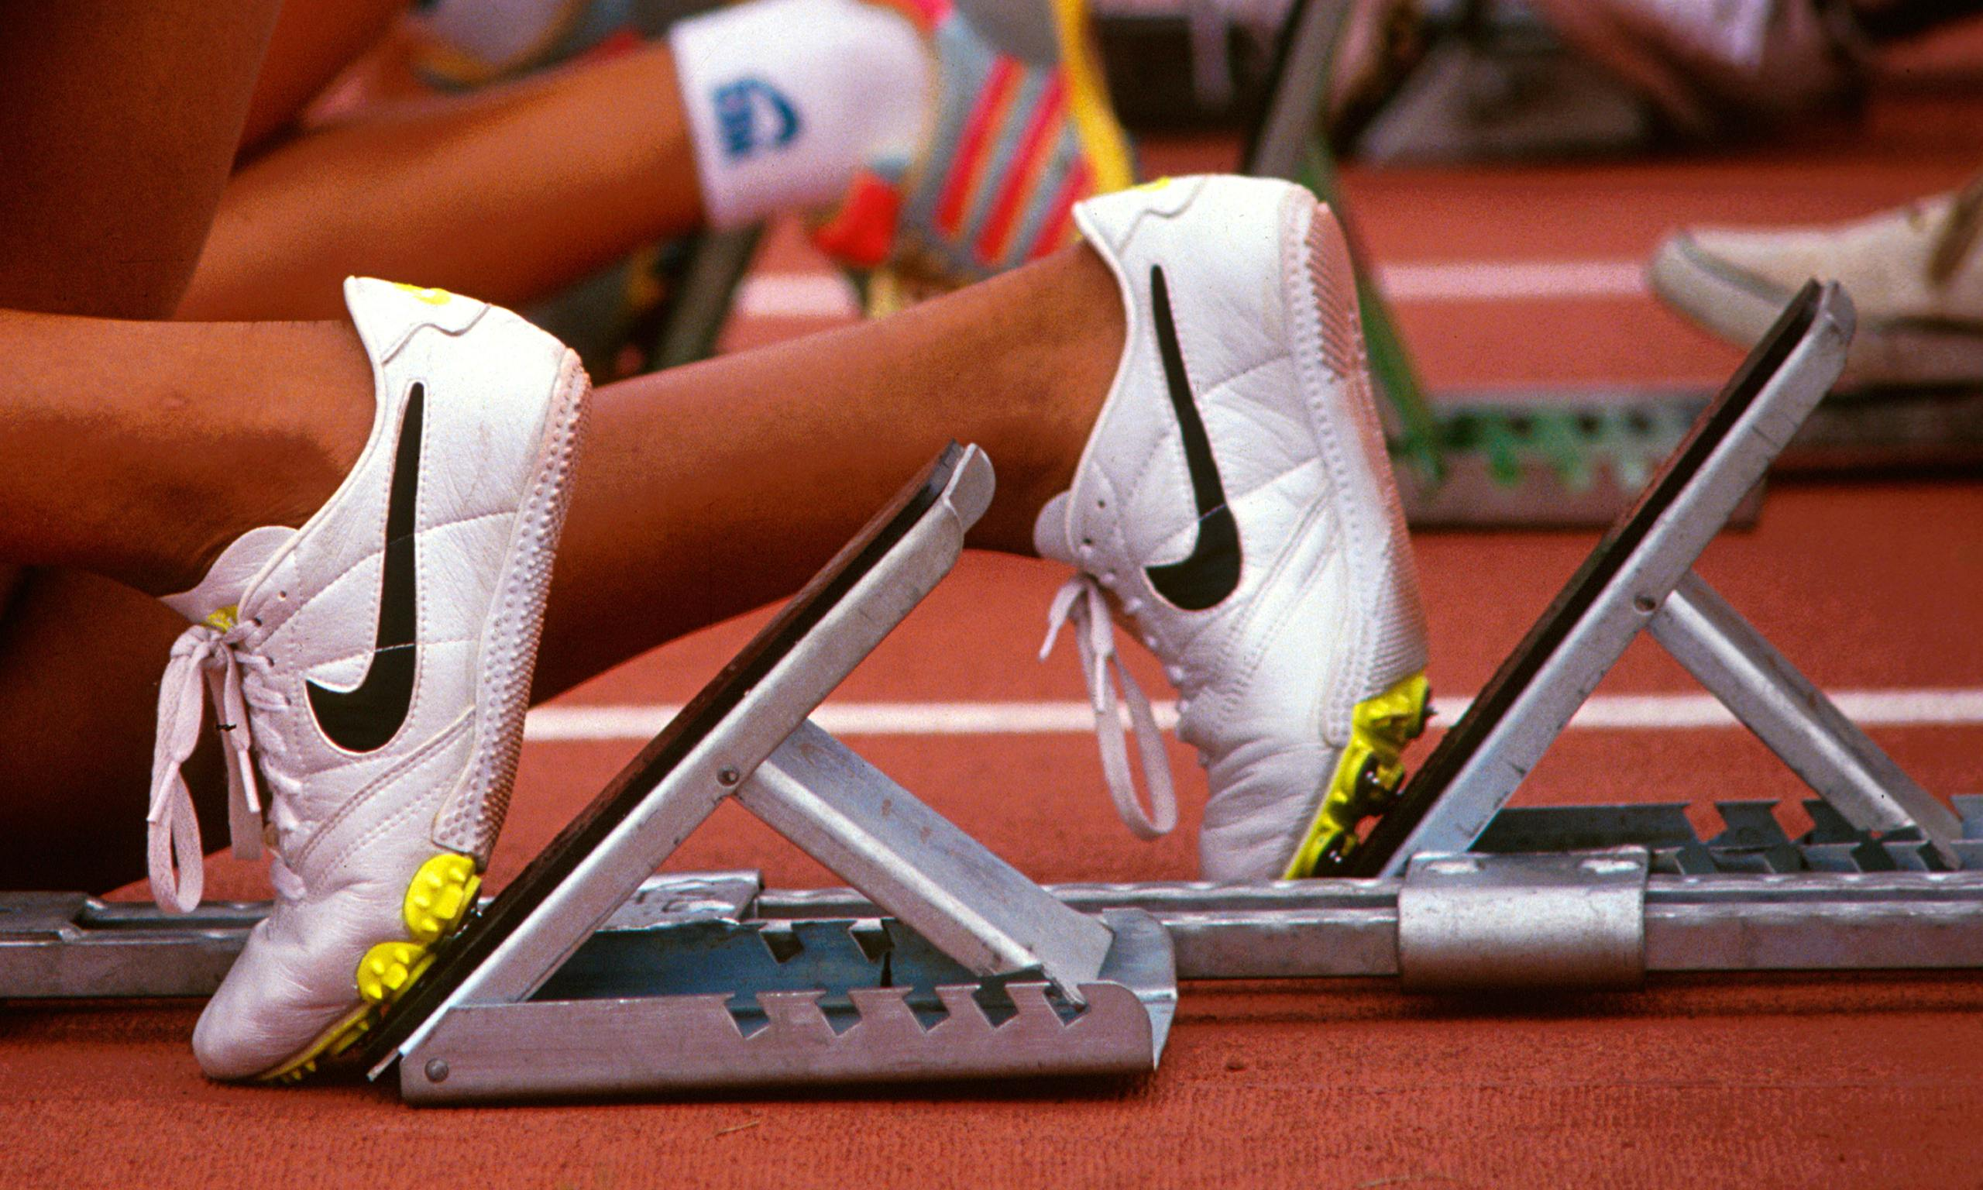
...running a race

Slide 2
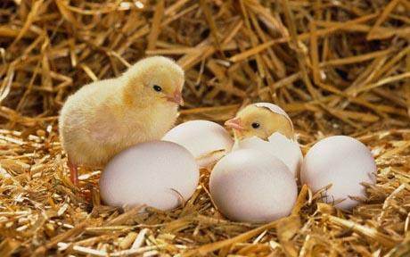
...chicks hatching from an egg

Slide 3
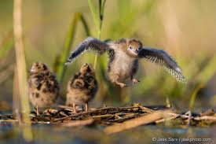
...learning to fly

Slide 4
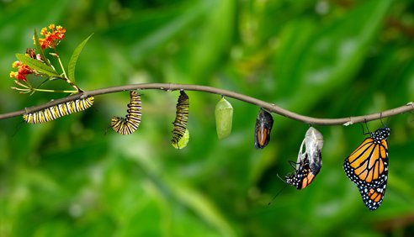
...caterpillar to butterfly

Slide 5


Slide 6
What is the connection?

Slide 7
They are all about the start of something new, a new life, the start of a race, the start of a new school year…
-What are you excited about this year?
-What are you going to get better at this year?

Slide 8
This week you are doing something a little different:
In class you are going to be spending the time to get to know each other, learning about all your individual talents.
This is your chance to shine!

Slide 9
Things to remember:
-Behaviour both in school and out
-Pride in ourselves
-Celebrating our successes
-Supporting each other when things get tough
-Being the greatest versions of ourselves

Slide 10
For this week I am looking for the class who demonstrate excellence in their behaviour and attitudes as well as pride in themselves.
This will include the class who line up the best and walk into school quietly and sensibly.
There will be a prize for this class!

Slide 11


Slide 12
Heavenly father
Bless our school
Join us together in friendship
So that we may
Work together
Play together
And grow together
Today and everyday
Amen.

