Slide 1
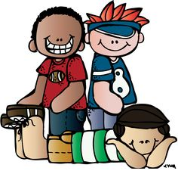
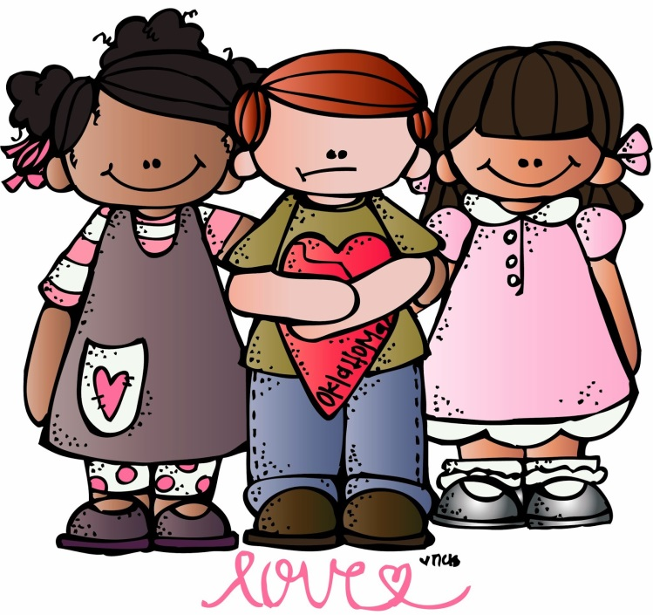
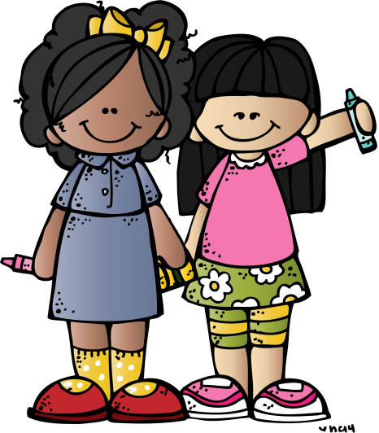
“Love your neighbour as yourself”
Matthew 22:39
Notes:
Children coming to Bruno Mars ‘Count on Me’
Good morning everybody, my name is Miss Nickson and what a pleasure it is to see you this morning.
Today in our wonderful worship we’re going to be thinking about something very important, so important in fact that it is God’s second commandment.
‘love your neighbour as yourself’
The reason this is such a pleasure for me today is because when I was your age, I too used to sit in this very school hall, listening to worship and the word of God; so for me it is very exciting to be here today.
When we think about ‘love your neighbour as yourself’, who do you think Jesus is talking too? Put your hand up if you think you know? If someone hasn’t put their hand up whisper the answer to them (everyone puts hand up)
Jesus is saying to us; If we love the Lord God with all our heart, soul and mind, loving our neighbour is the natural result. The question then is, who is our neighbour, and how do we love him or her?

Slide 2
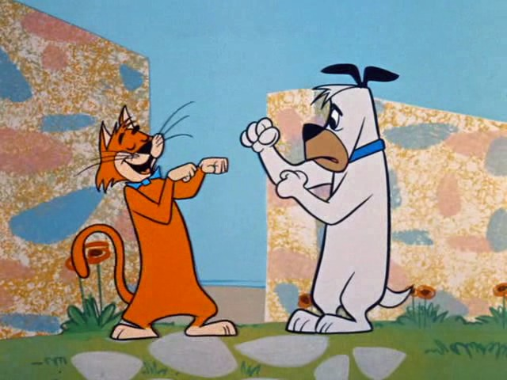
“Fight like cats and dogs!”
Notes:
So thinking about this very important message, I’m going to introduce to you 2 very important characters in my life. One is a cats and one is a dogs. Why do you think I have included a very old saying…’fight like cat and dog’? Tell the person next to you what you think that means.

Slide 3
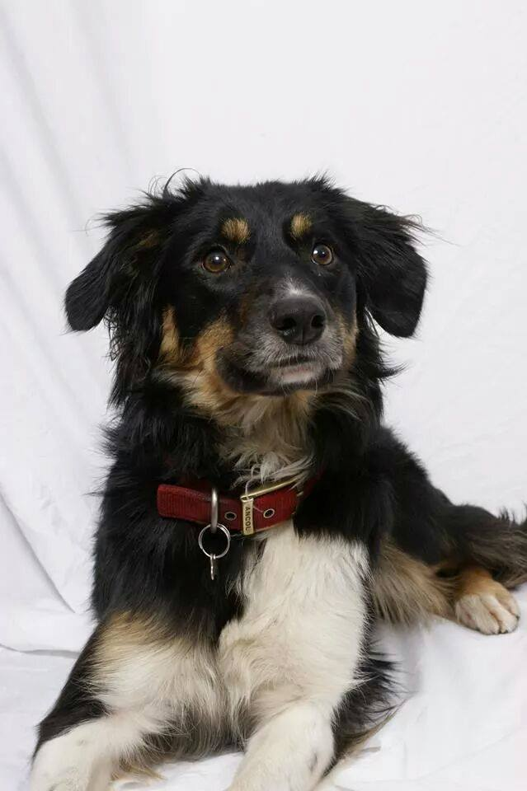
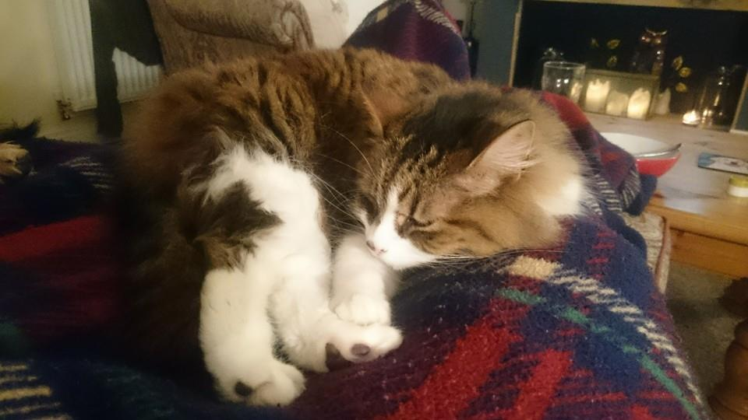
Tilly the Dog
Beatrice the Cat
Notes:
Well surprisingly the 2 main stars in my show are not your average cat and dog, in fact, Beatrice the Cat and Tilly the dog are very unique because they live in harmony together. This is surprising because we’re often told and you’ve already mentioned, cats and dogs are not supposed to be friends mainly because they are very different. So thinking about that, can you think of anything that is different about these two?

Slide 4
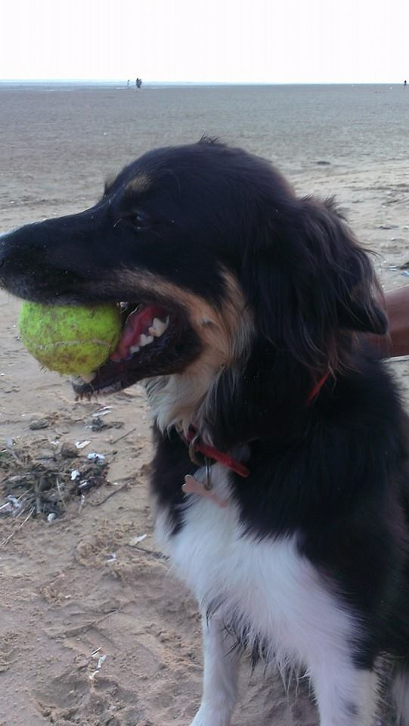
Differences?
Beatrice
Tilly
Cat
12 years old
Brown, black and white
Meows and purrs
likes to sit quietly and sleeps a lot
Hates water
Dog
5 years old
Black, white and tan
Barks
Likes to go on long walks
Loves water
Notes:
These have completely different personalities and have different tastes particularly when it comes to the things they find fun to do. For example, Beatrice lives to sleep all day and hates water whilst Tilly loves to be out on long walks playing the river. To be different is a good thing, God loves us all exactly as we are.

Slide 5
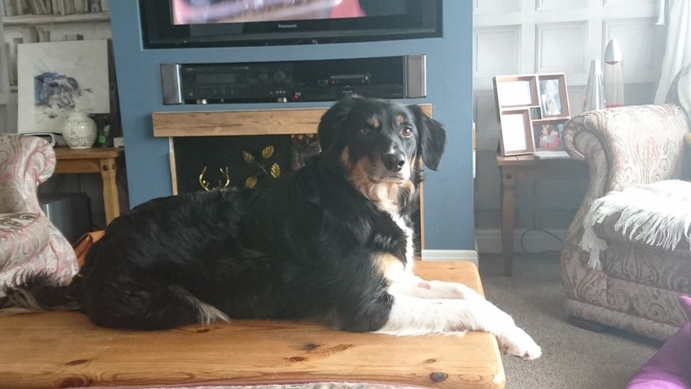
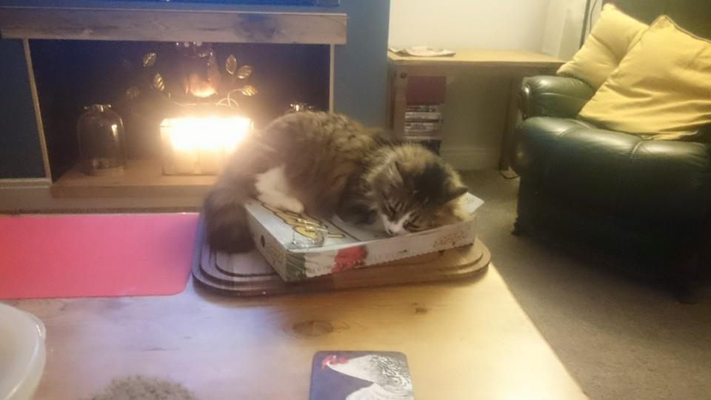
Similarities?
Basic
Extras
Need to be fed
Need clean water
Need to be kept safe
Need to be groomed
Need a warm bed
Need lots of cuddles
Special treats (toys and nibbles)
Like to sit on the coffee table or the sofa!
Notes:
They both love food, especially chicken and like to be pampered with lots of cuddles, strokes and treats. There is something else that is similar about them both and that is the way in which we treat them. Despite them being completely different they are both shown the same amount of love and care; we show them equality and treat them the same, ‘loving them’ as we love ourselves’.

Slide 6

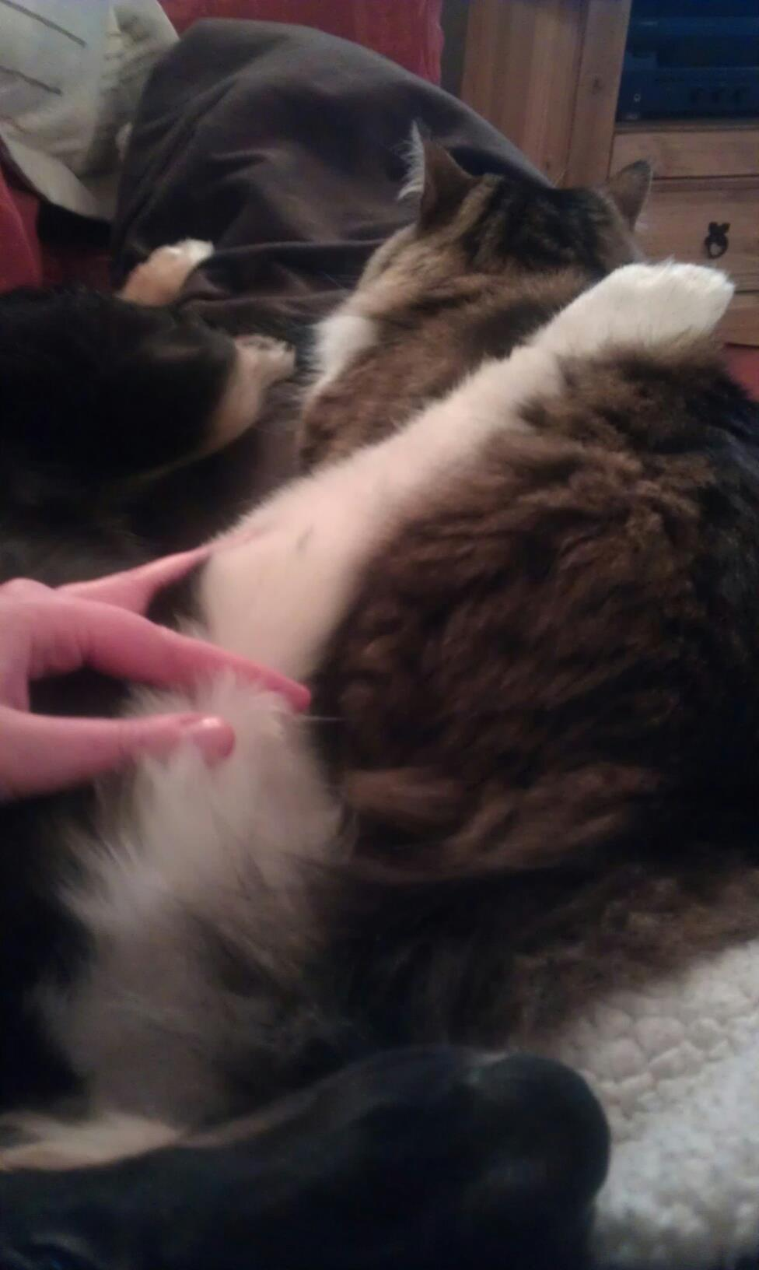

Notes:
And importantly, the most loveable similarity that Beatrice and Tilly share, is that they appear to love each other and enjoy sitting together as a family, despite being completely different to one another as you can see in the picture, Tilly is cuddling Beatrice. Would you have believed that they did that if I hadn’t got a picture to prove it?
Something you would have to have seen in order to believe.

Slide 7
The Good Samaritan

Slide 8
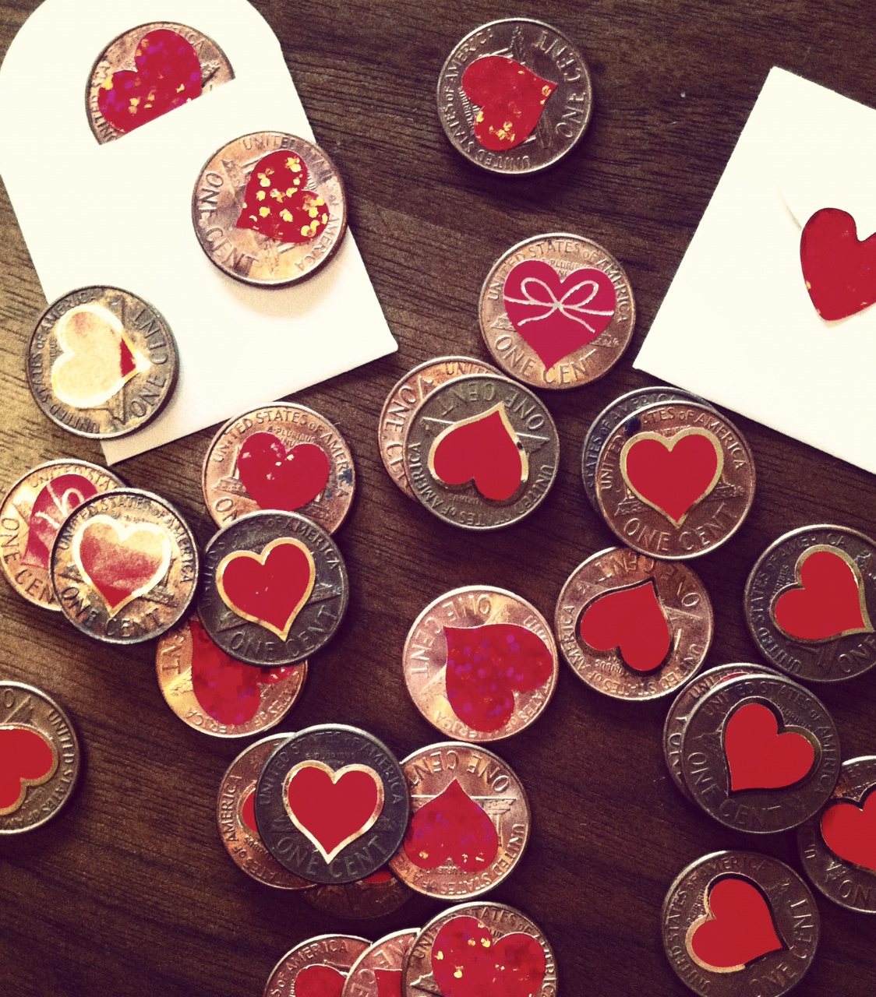
The Heart Penny Challenge
Notes:
I have a challenge for you at St Thomas’, Garstang-are you up for a challenge?
Regardless of their similarities and differences, together, all our pebbles helped to form a shore; each one completely unique but equally the same. So like pebbles, people too are completely different but all the same because we are all gods creation and god loves us all because we are unique and individual. God asks us to celebrate our similarities and differences with each other by ‘loving your neighbour as you love yourself’’
So thinking about all these wonderful acts of kindness that we can show, I want you to be our messengers, spreading the word about being kind and caring to each other; treating each other with love.
On every one of our pebbles is a heart; when you look at that pebble I want you to think of a way in which you can show love, to show love to someone or something, loving it in the way you would love yourself; in the way you would like others to show you love as Jesus taught us.
Now each of you is going to take a pebble away with you today, and when you meet someone who does something that makes you feel cared for and special I want you to pass the pebble on so that like Percy our kindness begins to spread until eventually our powerful pebbles have gone through the whole school passing on the love to our neighbours.

Slide 9
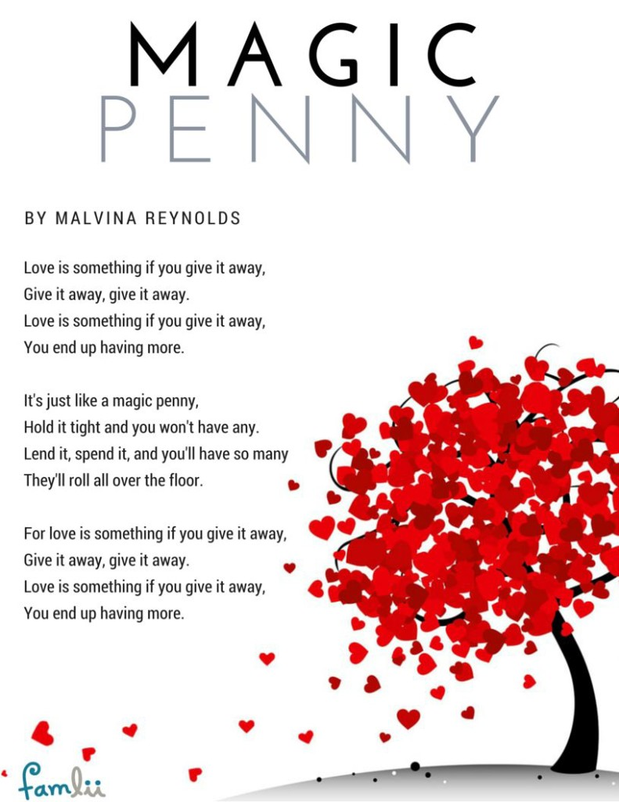

Notes:
‘Love is something if you give it away’
Whilst you each come and take a pebble I want to sing a song with you, about a magic penny

Slide 10


