Slide 1
Courageous Advocacy
Making a difference and Standing up for the things you believe in!

Slide 2
Acts 9:36
Now in Joppa there was a disciple named Tabitha. This woman was abounding with deeds of kindness and charity which she continually did.

Slide 3
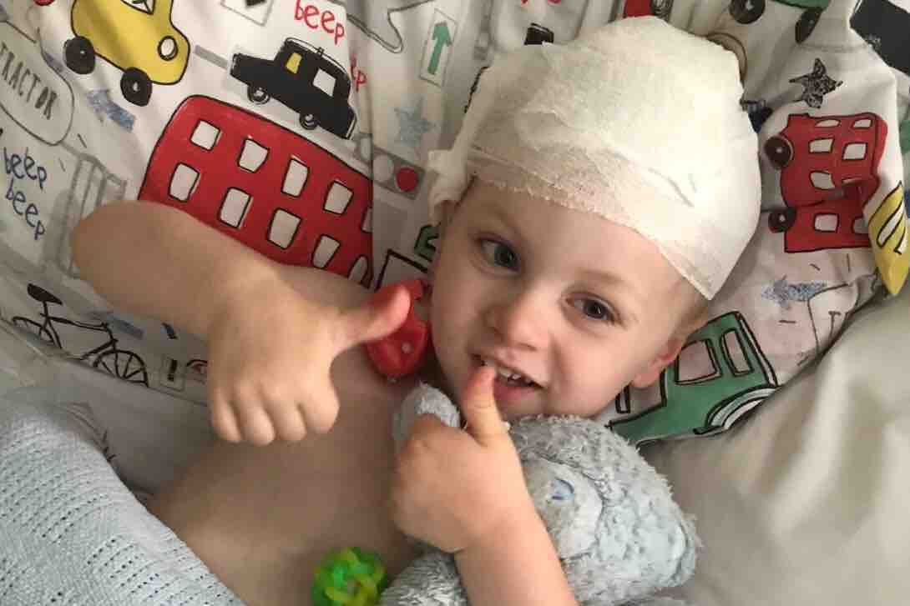

Slide 4
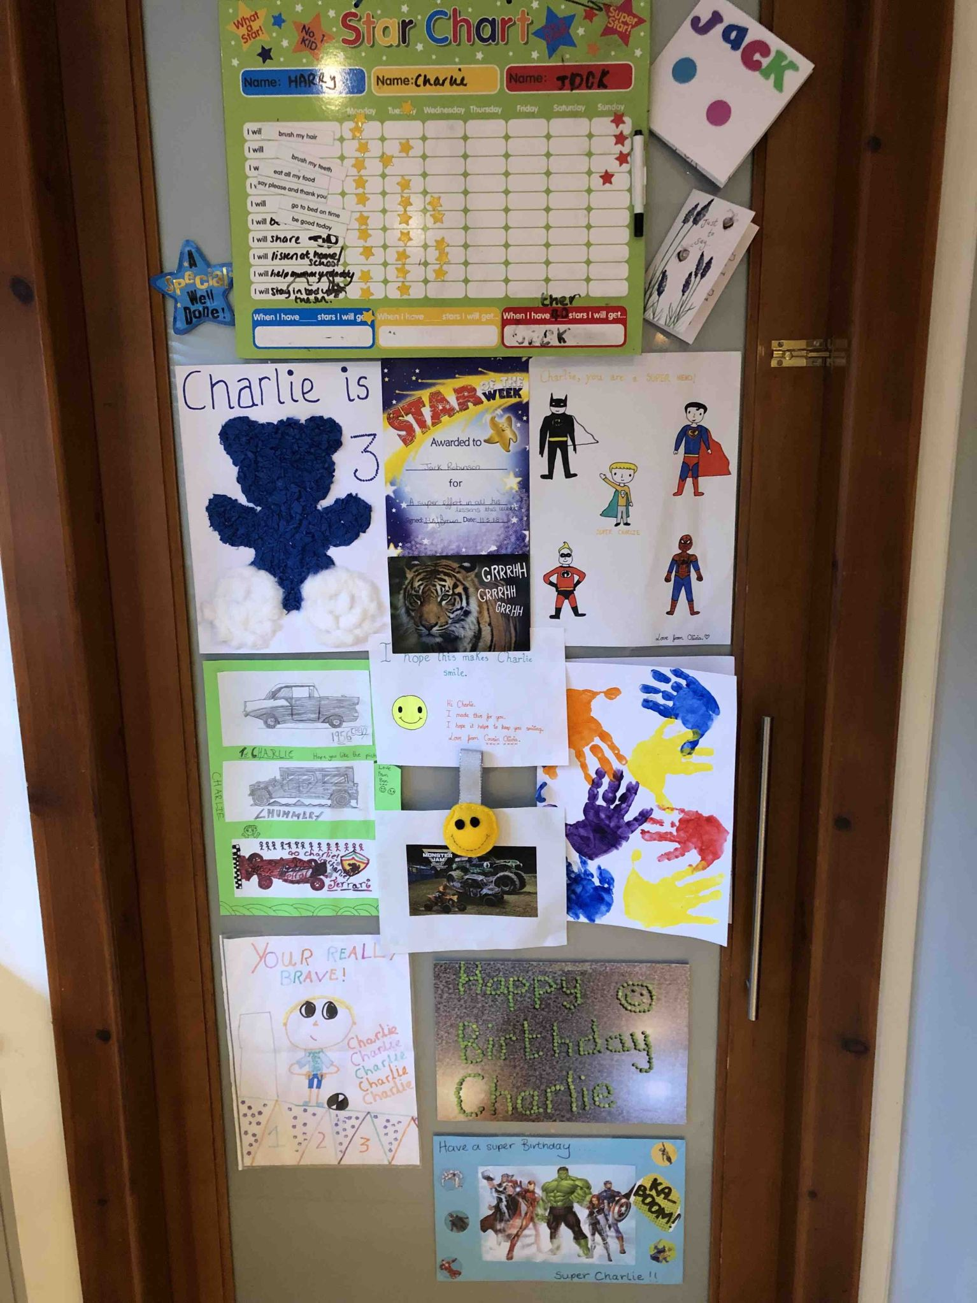

Slide 5
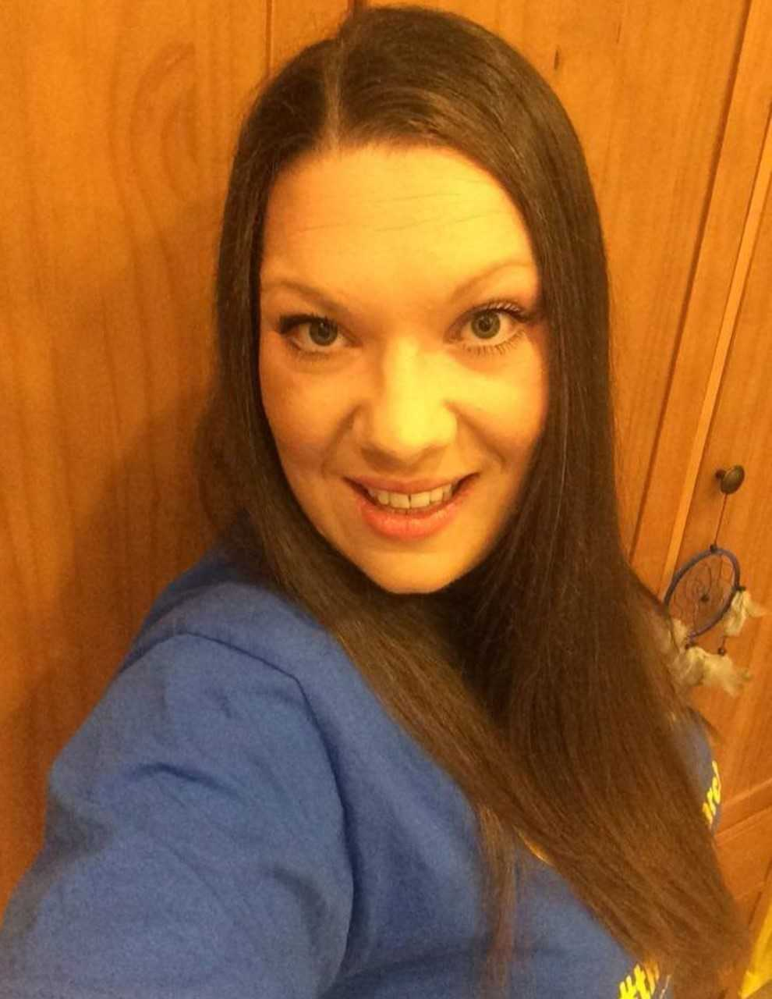
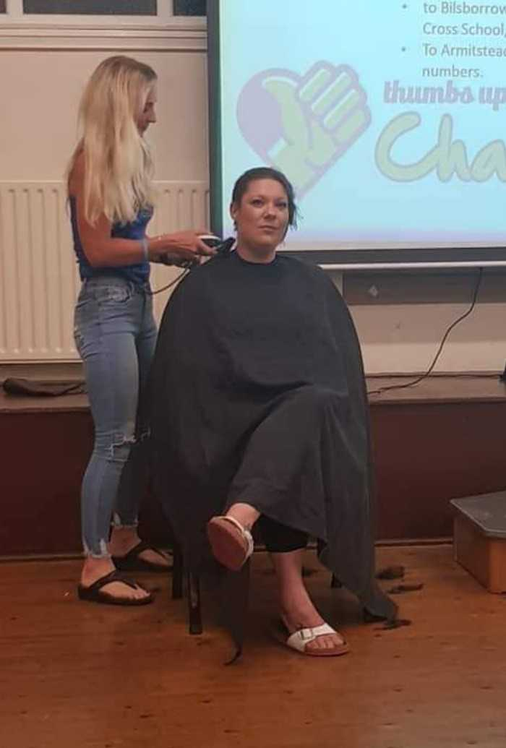

Slide 6
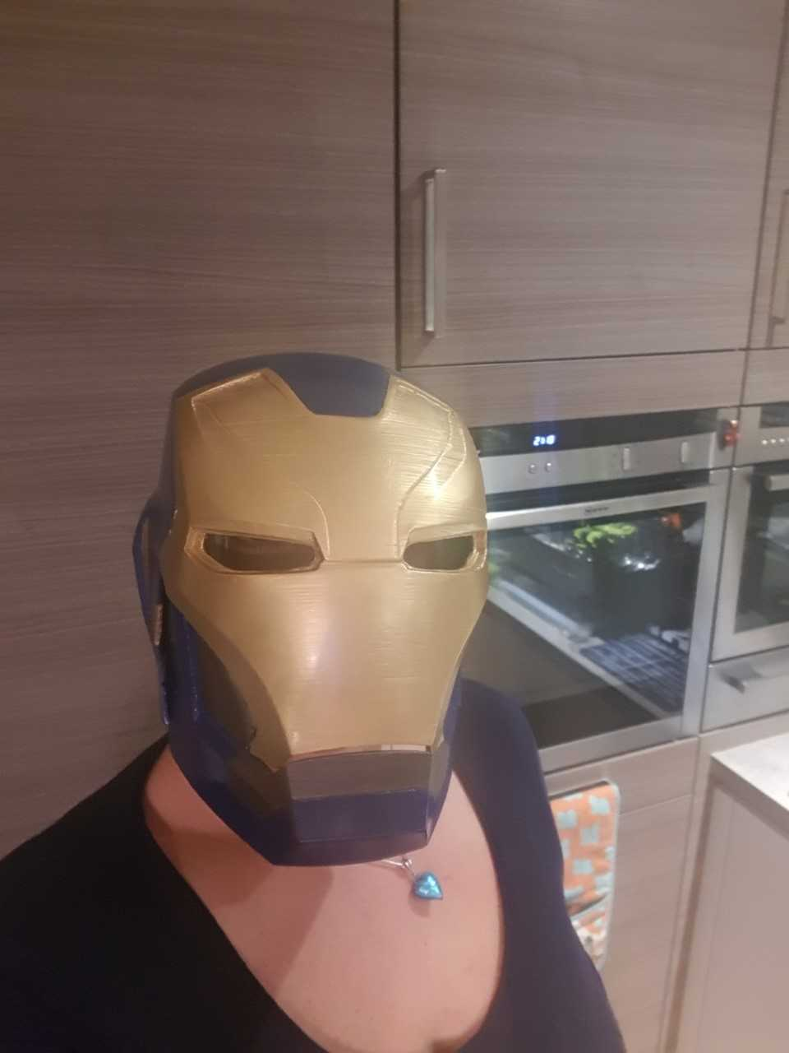

Slide 7
Though I speak with the tongues of men and of angels, and have not charity, I am become as sounding brass, or a tinkling cymbal. And though I have the gift of prophecy, and understand all mysteries, and all knowledge; and though I have all faith, so as to remove mountains, and have not charity, I am nothing. And though I bestow all my goods to feed the poor, and give my body to be burned, and have not charity, it profiteth me nothing.
Corinthians 13:1-3

Slide 8
To make a difference we must work together…
To look after our environment
To look after our neighbours
To look after ourselves
Acts of kindness will change the world for the better so what are you going to do about to make a difference?

