Slide 1
'Hope is believing that good things will happen.'

Slide 2
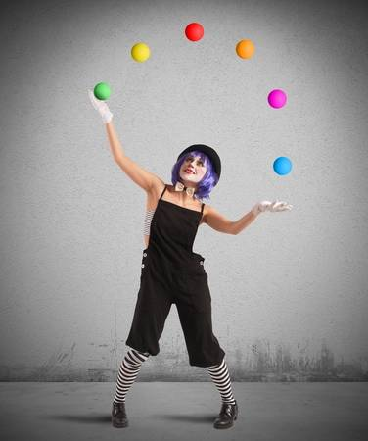
Future hopes…

Slide 3
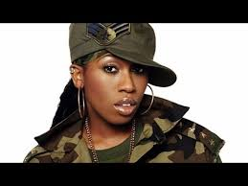
Future hopes…

Slide 4
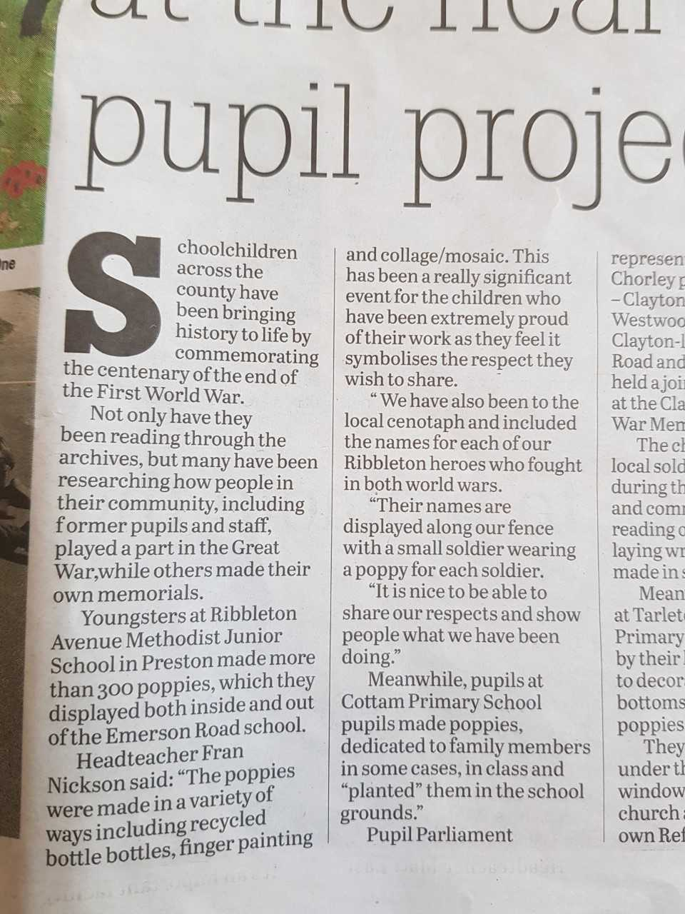

Slide 5
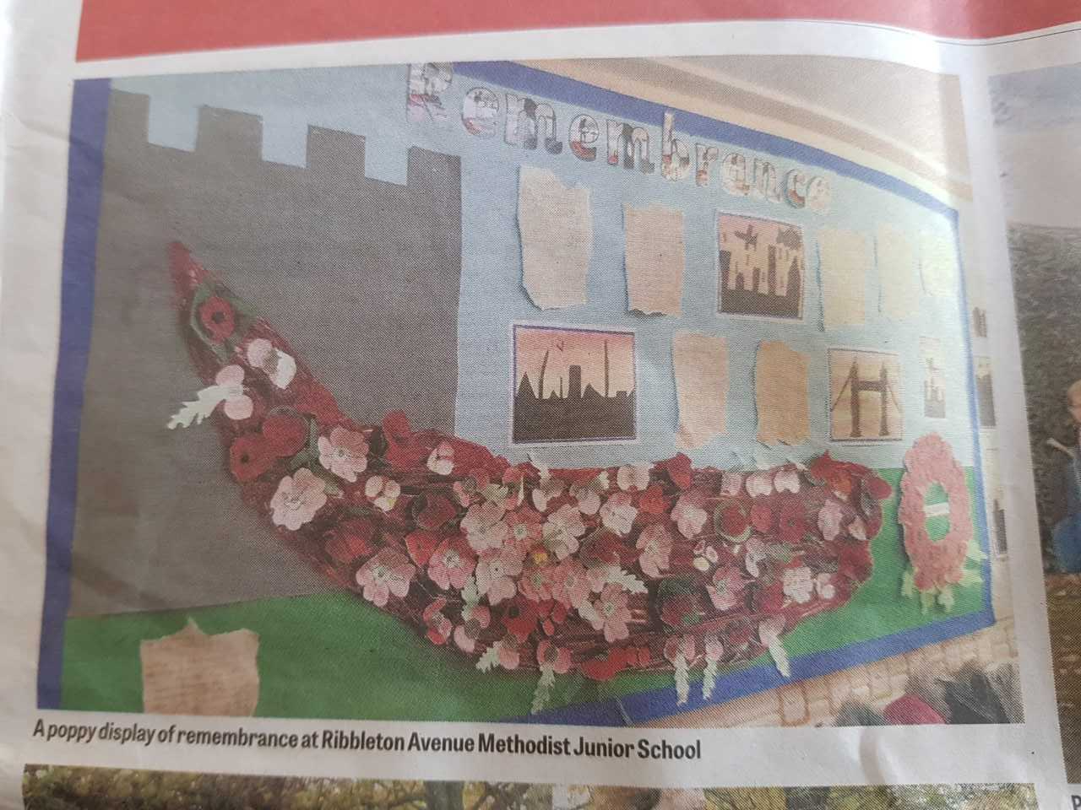

Slide 6

‘Put your hope in God.'

