Slide 1
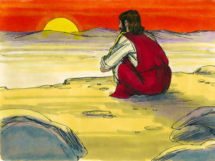
Jesus in the Wilderness
Courage and Faith

Slide 2
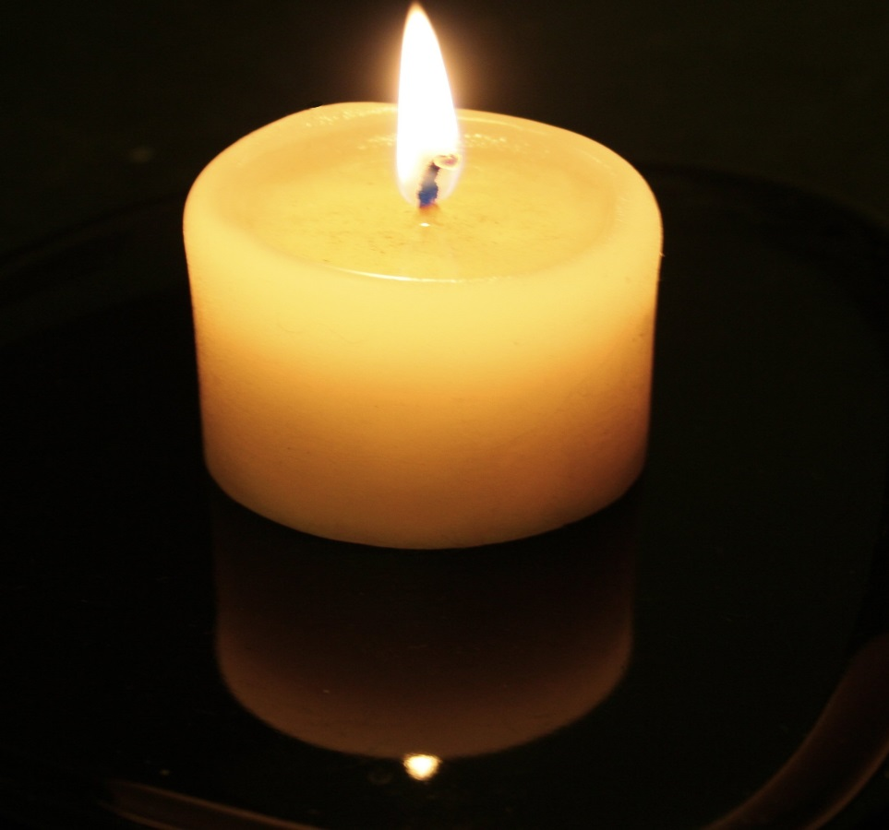
Today we are thinking about challenges, ones we may face, those others may face and how we overcome them.
The Candle symbolises the start of our worship Journey.

Slide 3

What is the biggest challenge you have faced and why was it so challenging?
How did this make you feel?
How did this make you behave?
The Mirror encourages us to reflect on ourselves.

Slide 4

How did someone help you?
What kindness was shown to you?
The Window let’s us look upon a time someone helped us in our time of need.

Slide 5

How could you use this learning to help others?
The Door encourages us to think of how we can move forward on our journey and how this could help others.

Slide 6
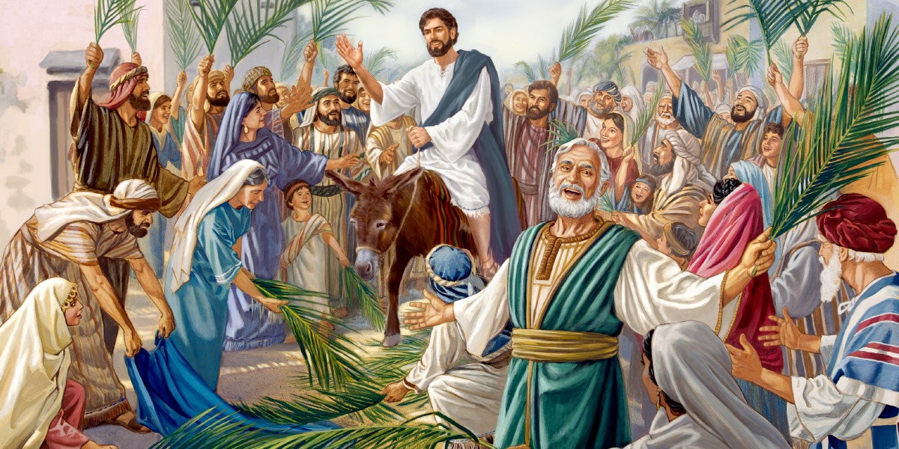
The Great Parade-Jesus Enters Jerusalem
Respect

Slide 7
Today we are thinking about Jesus entering Jerusalem, knowing he faced many great challenges ahead of him but remaining respectful to those around him.
The Candle symbolises the start of our worship Journey.

Slide 8
Have you ever been trying to share a message but no one is listening?
Have you known that your words could make you unpopular (e.g. telling the truth) but knew that they needed to be spoken?
The Mirror encourages us to reflect on ourselves.

Slide 9
What did you do?
How did you remain respectful to others, especially those who disagreed with you?
Who helped you to share your message?
The Window let’s us look upon a time someone helped us in our time of need.

Slide 10
How could you help others to share their message or meaning respectfully?
The Door encourages us to think of how we can move forward on our journey and how this could help others.

Slide 11
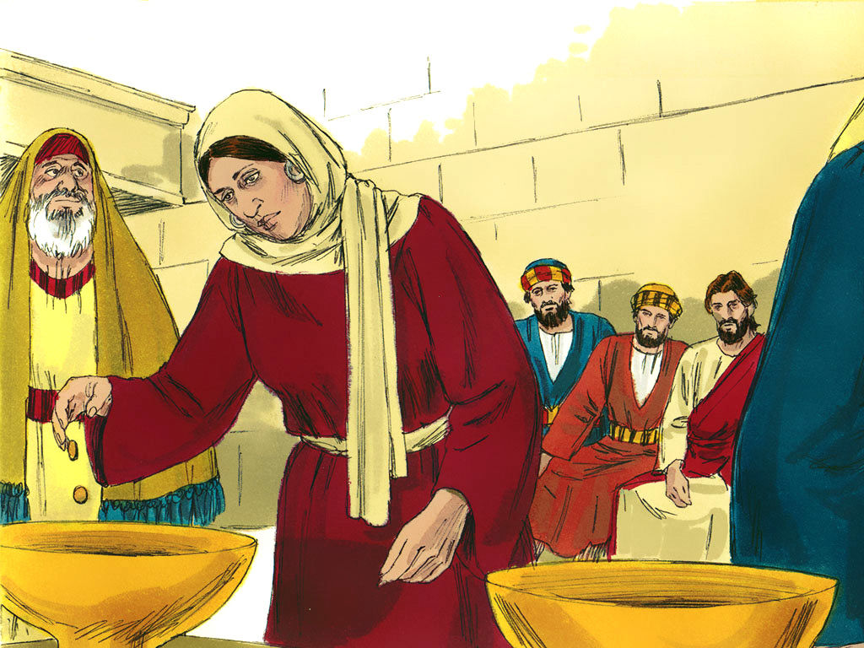
The Widow’s Coins
Courage, Faith and Hope

Slide 12
Today we are thinking about giving all we can.
If we give our all, is that enough?
The Candle symbolises the start of our worship Journey.

Slide 13
Have you ever worried that what you had to give was not enough?
How did you feel giving your all but worrying it was too little?
The Mirror encourages us to reflect on ourselves.

Slide 14
What did you do to overcome this?
What did you learn from overcoming your fear?
Did anyone help you?
The Window let’s us look upon a time someone helped us in our time of need.

Slide 15
What words of advice would you to someone who didn’t feel good enough?
How could you encourage their courage and faith?
The Door encourages us to think of how we can move forward on our journey and how this could help others.

Slide 16
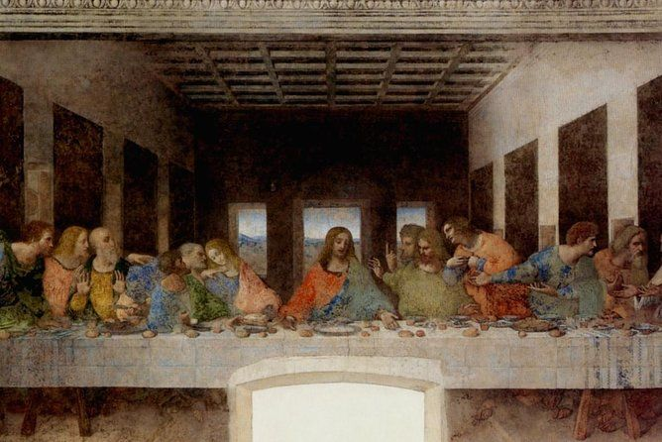
An Important Meal-The Last Supper
Hope and Faith

Slide 17
Today we are thinking about betrayal and forgiveness.
Despite Judas’ betrayal of Jesus, he is forgiven.
The Candle symbolises the start of our worship Journey.

Slide 18
Have you ever felt let down by someone close to you?
Have you ever let someone down and if so, how did that make you feel?
The Mirror encourages us to reflect on ourselves.

Slide 19
How could you overcome this feeling of hurt?
Would you be able to forgive?
Would you hope to be forgiven?
The Window let’s us look upon a time someone helped us in our time of need.

Slide 20
If you were one of Jesus’ disciples, what advice would you give to Judas?
What would Jesus have done?
The Door encourages us to think of how we can move forward on our journey and how this could help others.

Slide 21
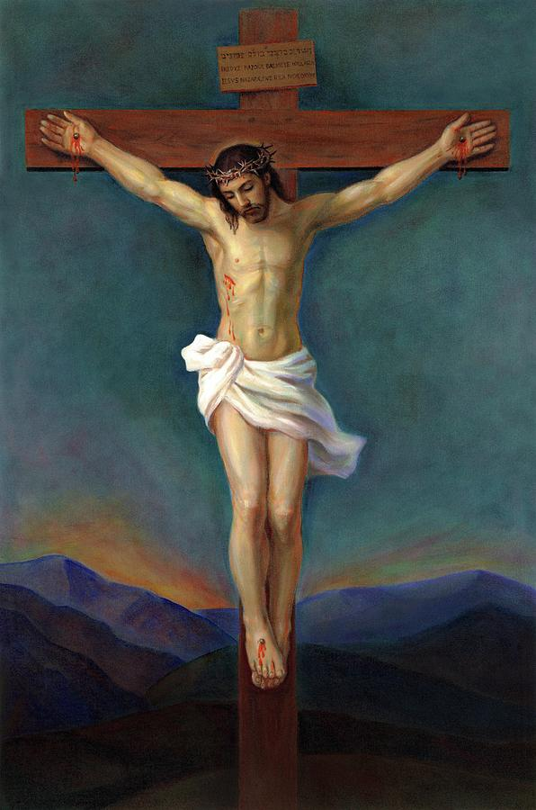
A Dreadful Day
Courage, Faith, Hope, Love and Respect

Slide 22
Today we are thinking about Jesus being placed on the cross. Jesus watched those around him turn on him and deny him. Despite this, Jesus never lost faith.
The Candle symbolises the start of our worship Journey.

Slide 23
Has your trust in someone close to you ever been lost?
How did you keep your faith and live your own personal values?
The Mirror encourages us to reflect on ourselves.

Slide 24
How did you restore your faith in others?
Who helped you to trust again?
The Window let’s us look upon a time someone helped us in our time of need.

Slide 25
How could you encourage others to forgive and show courage at a time of hurt and challenge?
What advice would you give to Jesus?
The Door encourages us to think of how we can move forward on our journey and how this could help others.

