Slide 1
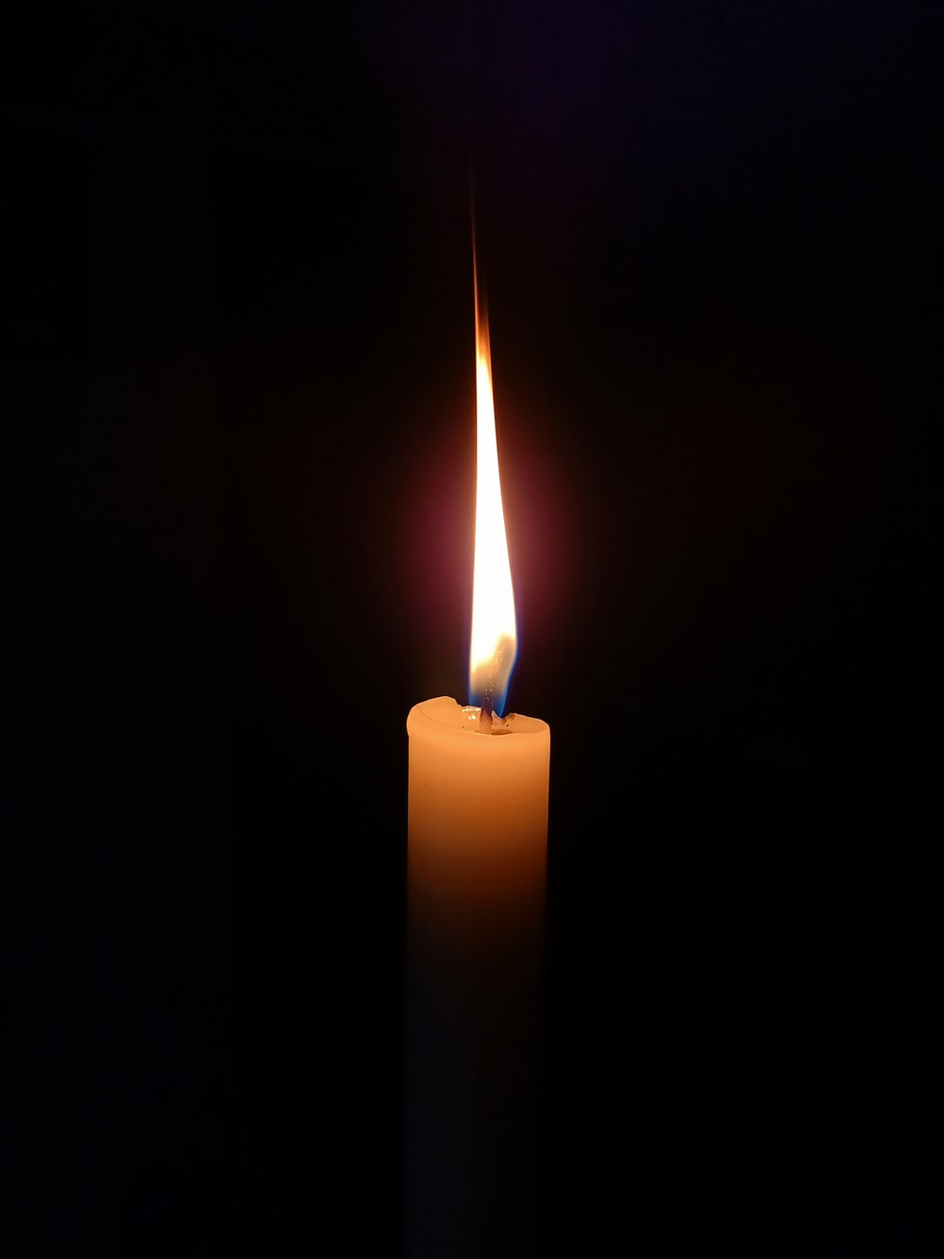
Weekly Worship
I have used Christian stories from the Bible as part of our Methodist culture to give examples but please use your own examples, stories from your faith to develop your ‘Trust in God’ and please share your examples on Seesaw.
Use the words in this song to take a moment of quiet and prepare to worship.
Whilst we may not share the same God, we share one school community and our values support us in our development of:
Ambition
Courage
Respect
Love
Hope
Faith
Here I am To Worship
https://www.youtube.com/watch?v=8fdk0oKMmfg

Slide 2
Trusting God
Is it always easy to trust in God?
When do you find it hard to trust in your God?

Slide 3
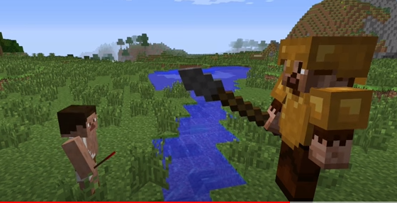
David and Goliath
https://www.youtube.com/watch?v=lf39lefpgW0

Slide 4
David was a person who trusted God.
The situation for David looked pretty bleak. An army were wanting to defeat God’s people and they had a GIANT to help them do it! But David knew he had to trust God and stand up for God’s people.
It can’t have been easy for David to approach Goliath. To look up at him in his full armour with just a slingshot and a few pebbles to defend himself. But David trusted God, even in the scariest of times.
  Have you ever felt small like David, facing the biggest of challenges and not sure how to overcome the obstacles in front of you?
  What did you do?
  Did you trust anyone to help you?

Slide 5

‘But Wholly trust in Jesus’ name’
Even when things seem scary, even when things seem sad, God is so good.
He is someone we can trust through the darkest of storms.
Always remember you can trust your God to look after you and to listen to your prayers.
This song is a Christian song about trusting in God-you may like to listen to it:
https://www.youtube.com/watch?v=YPrEg2JS384

Slide 6


Let’s Pray
Dear God,
Sometimes we find trusting You a hard thing to do, especially when things are scary are sad. Please help us to trust in You and have faith that You are doing all things for our good and for Your glory.
Help us to be a school who trust in Your love for us.
Amen

Slide 7
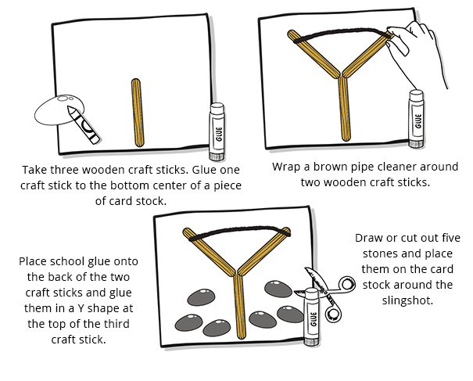
To have a go at home... recreate the slingshot used by David in the story:
If you don’t have lollipop sticks, you could use twigs from outside.
If you don’t have a pipe cleaner, string will do. You could even colour that part of the slingshot.
When you’ve created your slingshot, why not add these words from the bible above it to remind you of the story.
‘The battle is the Lord’s.’
1 Samuel 17:47

Slide 8
Don’t forget to share your work on Seesaw:
If you wish to do something different you might like to:
Do a comic strip retelling of the story
Design a poster to encourage people to trust in God
Write your own song about trusting God/others
Any other wonderful thing you might like to undertake ☺
I can’t wait to see your work-Stay Safe
Mrs Nickson x

