Slide 1

RAMJS Worship
Theme: Patience / Calm / Silence
Our Value: Faith

Slide 2
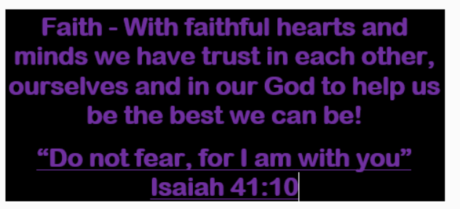

Slide 3
British Values Worship Charter for behaviour
We model our British Values in worship by displaying: Tolerance: We do not dismiss the views or opinions on others We discuss things in a sensible and respectful way Democracy: We join in and respond during worship to help influence the way our school works together Individual Liberty: I am free to have my own thoughts and make choices but I recognise that I am accountable for my actions Mutual Respect: I recognise that everyone is entitled to their own opinions as long as it does not promote extremism or cause offence I respect that everyone has a voice during worship I will listen to others as I would like to be listened to Through engagement / sharing or ideas/ listening the opinions of others The Rule of Law: I understand school rules are used to mirror society’s laws and must be respected I recognise there will be a consequence for my actions Responsibility: I am equally responsible for my learning as my teachers I am responsible for my actions –Good or Bad I have a responsibility to promote and protect the wellbeing of others

Slide 4
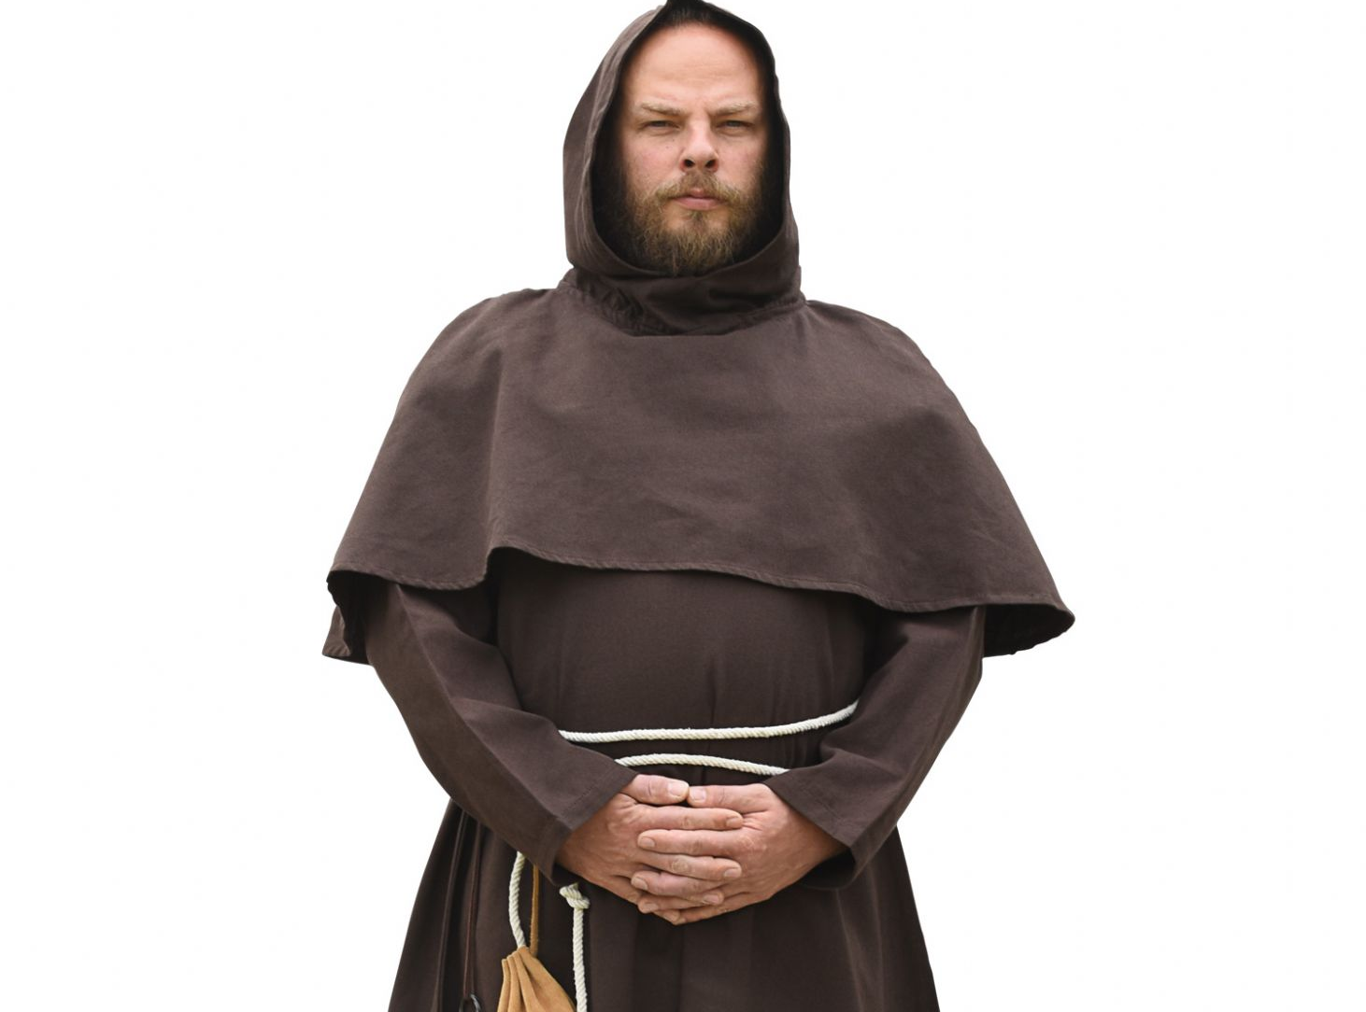

Slide 5


Slide 6
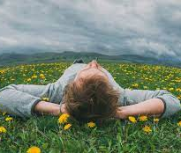
Benefits of regular silence:
To do more – time out can make us feel more energetic
Shutting off speech will make the other sense work better
Realise and think about what is important
Improve memory
Develop you imagination
Increase self-awareness
Grow your brain (10 minutes sitting in silence thinking about peaceful scenery can actually thicken the grey matter in your brain)

Slide 7


Slide 8

How to take a time out:
Listen to yourself breathing
Listen to your heartbeat
Think about now, not yesterday, not today, not tomorrow, but now
Talk a walk
Realise what you think about – think about what you think about
Visualise a peaceful scene
Try to draw a peaceful scene, it doesn’t need to be perfect
When a ‘but I must…(finish my game)’ thought appears, wait for it to disappear
If thoughts about a problem appear-tackle them
Think about a problem as if it were someone else looking at the problem

Slide 9
Reflection Prayer
Dear God,
In our community, our school and our families we know that life can be noisy, busy and sometimes stressful.
Today may we be reminded of the importance of quiet times. Help us to remember the benefits of a regular time out. Help us to form good habits, building these times into our busy and often noisy lives.
Amen

