Slide 1
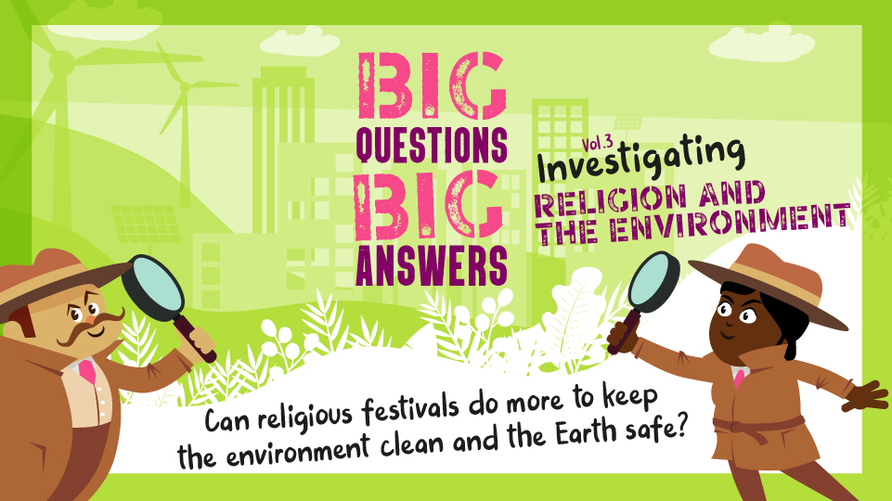

Slide 2

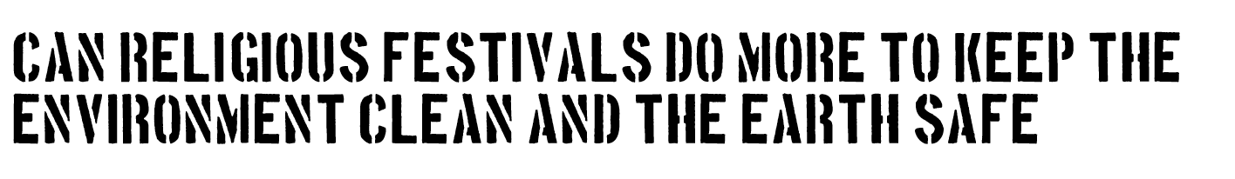

Essential Knowledge in RE
What will you learn?
Some Hindus, Muslims and Christians are trying to make the ways they celebrate Divali, Eid-Al-Fitr and Christmas more environmentally friendly. Some people call this ‘greening the festivals’. Can you think about why this matters and what this means?
Members of these three religious communities each look to their own scriptures to give them inspiration in ‘greening the festivals’.
Muslims, Hindus and Christians see a link between their ideas about Brahman, Allah, God and the reasons they want to work to make the future of the earth safe and sustainable.
How will you learn?
You will find out how to use religious and scientific information to develop reasoned examples of ideas that can reduce our environmental footprint
You will find out how – for many religious people – scripture and their faith tradition and community inspire then to put values of care for the earth into action.
Look at the image on the next slide (your teacher will give your group a copy to write on). First of all point out the 12 things listed at the edge of the picture to the other people in the group. Can you guess what these have to do with ‘greening the festivals’?
BIG QUESTIONS BIG ANSWERS – Investigating worldviews Editor: Fiona Moss © RE Today 2021

Slide 3
Bus
Family fun
Fireworks
Gift box
Goddess
Homemade snowman card
‘Litter free’ sign
Marmalade
Natural decorations
Recycleable box
Tree
World
Can you see the symbols of Hindus, Muslims and Christians as well?
© RE Today 2021​

Slide 4
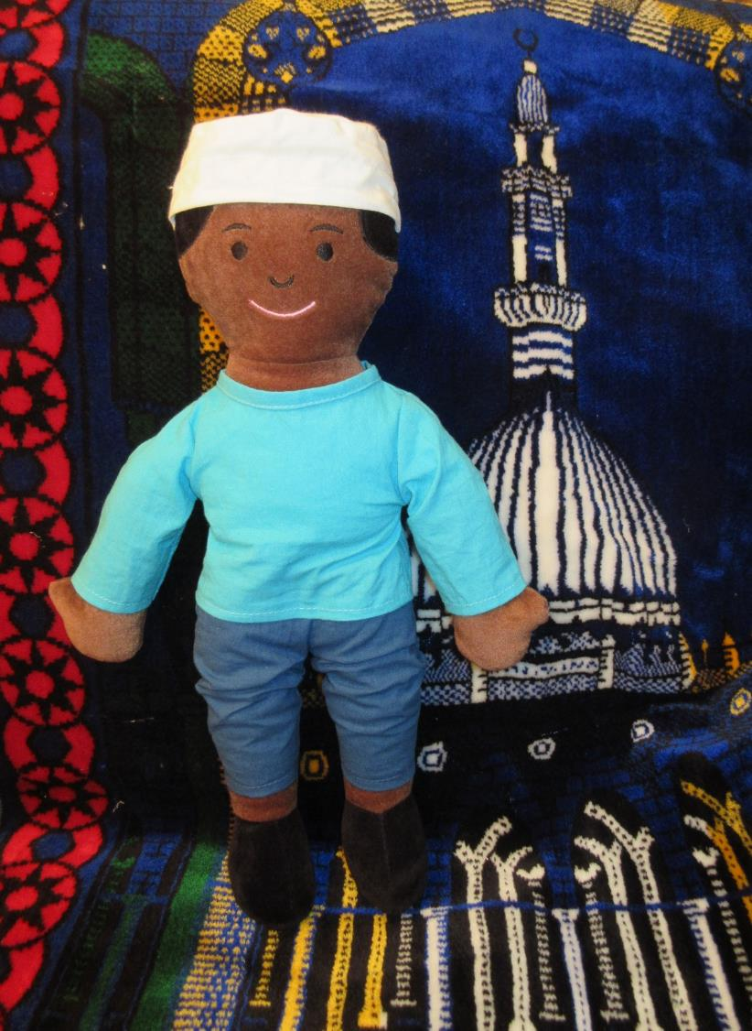
Omar is a Muslim, He is 5. His ‘big day’ is Eid Al Fitr"
Everyone at Omar’s mosque wants to have an ‘eco-friendly’ Eid this year. They have thought of four ideas.
The Qur’an says ‘O Children of Adam! wear your beautiful apparel at every time and place of prayer: Eat and drink: but don’t be wasteful or excessive. Allah doesn’t love the wasters." (Qur'an, 7:31). We have a big picnic for Eid in the park and thousands join in. This year we will finish off with everyone picking litter before we go home. We are going to leave the park just perfect.
The Qur’an says believers in Allah are those who “walk on the Earth in humility.” (Qur'an, 25:63). This Eid we will give thanks to Allah for the lovely world, and pray for ideas to treat our planet better.
Everyone gets together at Eid, in the park - it makes bad traffic and air pollution. We have all agreed this year to use buses or walk to the celebrations. The mosque is paying for free buses.
New clothes for Eid – that’s what usually happens. This year, we are all going to wear some of our favourite clothes, but not buy new ones.
Which ideas will make a big difference to ‘greening the festival’?
© RE Today 2021​

Slide 5
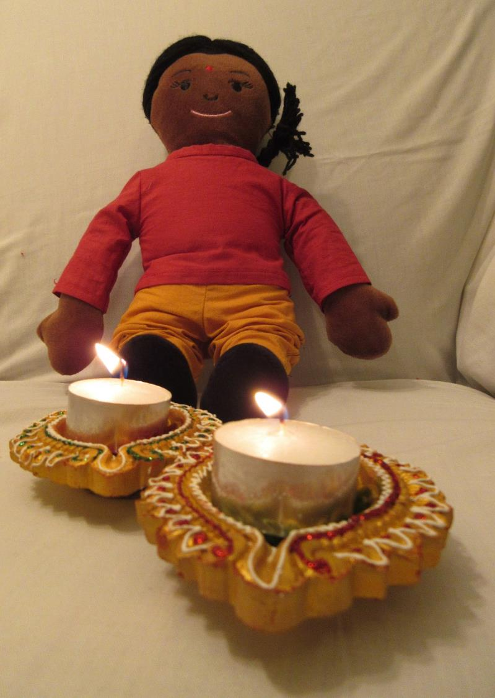
Priya is a Hindu. She is 6. She celebrates Divali. Priya’s family and community want to make sure that Divali is not a time of waste and pollution. Here are their four ideas.
We’re having less expensive fireworks this year but also more singing and dancing at Divali. It cuts down on cost and pollution: less money going up in smoke! And less frightening for pets too.
At Divali we always love food from the take away shops. We are going to choose shops which use cardboard which can biodegrade, not plastic or foil trays.
In the Divali story, Rama and Sita go to live in the Forest of Vrindavan. We are going to make our own decorations, using leaves and flowers from gardens, just like the way Rama and Sita lived in Vrindavan.
We are going to celebrate out of doors, and pray to goddess Bhumi to give us courage and ideas to help save the earth (she is goddess of the Earth).
Which of these ideas do you think will make a big difference?
© RE Today 2021​

Slide 6
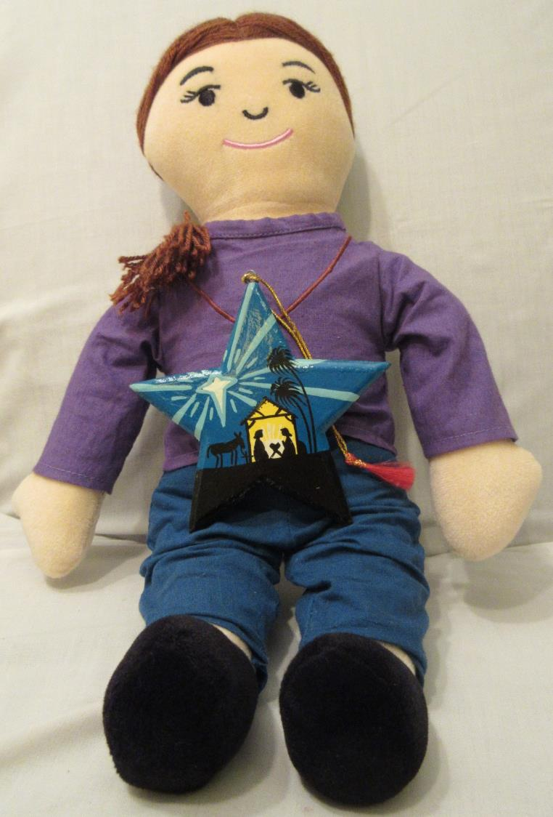
Joanna is a Christian. She is 6. Her festival is Christmas. Her church has four ideas for a greener festival. What do you think of them?
Everyone likes a Christmas tree, but it means millions of trees grow for a few year, sit in a house for a few weeks and then get thrown away. We’re going to use artifical trees that can last ten years, and make some decorations of our own instead of buying ones made in China!
We think that too much money is spent on presents and cards, which maybe people don’t even like. We are going to make half our presents and cards ourselves this year. We think it will be fun.
Wrapping paper is a bit of a waste. We are going to use recycled gift wrap for all our presents this year.
At church, we have hundreds of Christingles made of oranges for a special service. Lots of the oranges are thrown away, so this year we will collect them – and make marmalade. They get boiled, so it will be quite safe, and everyone can get marmalade for New Year.
Which for these four ideas do you think will make a big difference?
© RE Today 2021​

Slide 7
Bus
Family fun
Fireworks
Gift
Goddess
Homemade snowman card
Litter free
Marmalade
Natural decorations
Recycleable box
Tree
World
© RE Today 2021​

Slide 8
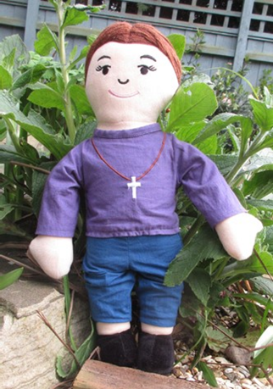
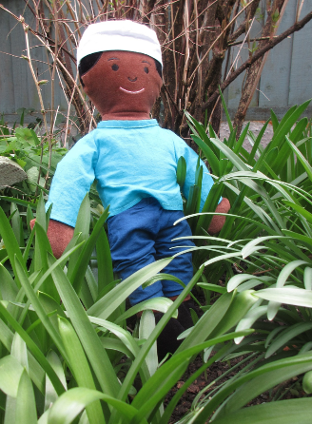
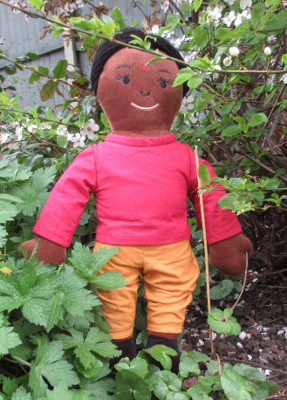
Now think about the different beliefs which Omar, Priya and Joanna might have about God and about our beautiful world.
The next three slides will teach you what they have been learning – at a Hindu mandir, a Muslim mosque and a Christian church.
Can you remember what you learn? There will be a quiz!
BIG QUESTIONS BIG ANSWERS – Investigating worldviews Editor: Fiona Moss © RE Today 2021

Slide 9

Omar is a Muslim, He is 5. His ‘big day’ is Eid Al Fitr" Everyone at Omar’s mosque wants to have an ‘eco-friendly’ Eid this year. They have thought of four ideas.
The Qur’an says ‘O Children of Adam! wear your beautiful apparel at every time and place of prayer: Eat and drink: but don’t be wasteful or excessive. Allah doesn’t love the wasters." (Qur'an, 7:31). We have a big picnic for Eid in the park and thousands join in. This year we will finish off with everyone picking litter before we go home. We are going to leave the park just perfect.
The Qur’an says believers in Allah are those who “walk on the Earth in humility.” (Qur'an, 25:63). This Eid we will give thanks to Allah for the lovely world, and pray for ideas to treat our planet better.
Everyone gets together at Eid, in the park - it makes bad traffic and air pollution. We have all agreed this year to use buses or walk to the celebrations. The mosque is paying for free buses.
New clothes for Eid – that’s what usually happens. This year, we are all going to wear some of our favourite clothes, but not buy new ones.
© RE Today 2021​

Slide 10

Priya asked a priest at her Mandir ‘How and why do we worship Goddess Bhumi? Is it important for Hindus to care for the earth?’ Here are the answers.
“When we start to build a new mandirs and other buildings too we hold a special act of worship called ‘Bhumi Puja’. We use incense, lamps and gifts to the goddess and we pray that Bhumi will accept and bless our building.”
“Bhumi Devi is the goddess of the Earth, our ‘Mother Earth’. We Hindus teach that she is Vishwambhara (All-Bearing), Vasudhaa (the producer of all wealth) and Pratishtha (the foundation on which we live).”
“Because these good things come from Bhumi, it is also very important for all Hindu devotees to love the Earth and take great care to be humble and kind to the Earth. This is especially important these days as we work to deal with the climate crisis.”
© RE Today 2021​

Slide 11

Joanna is a Christian. She asked her Pastor at church: can Christians do more to help save the planet? What does the Bible teach about this?
“Yes, Christians can do lots more to save the planet, and we must. We haven’t been very good at this in the past! The Bible says that God made the Earth good (Genesis 1), but we have often spoiled it.”
“I think Jesus loved the world of nature – he noticed sparrows, doves, pigeons, hens, foxes, flowers and fruit trees. We should follow Jesus and care for the earth too. Some Christians teach that we are God’s Stewards.”
“It is God who own the earth, which he made, and loves, and saves. God gives us the task of caring for the planet. In the Psalms, one song says ‘The earth is the Lord’s and everything in it, the world and its inhabitants too, because God is the one who established it on the seas; God set it firmly on the waters.’ (Psalm 24:1-2).”
“God is pleased, I believe, when humans love the Earth and care for it and protect it.”
© RE Today 2021​

Slide 12
Quiz: work with a partner
Which religious community has a mosque for its holy building?
Which religion has the Aum for its symbol?
Which religion has a leader who’s called the ‘Pastor’?
Name two of the ways Hindus celebrate Divali
Name two things Christians might do at Christmas
What was the religion of the child whose community are making new year marmalade?
What was the religion of the child who is making decorations from leaves and flowers this year?
Which holy book says ‘Allah doesn’t love the wasters’?
Which book in the Bible tells the story of God making the Earth?
For Hindu people, who is Bhumi?
Can you make up three more questions to challenge other children – or your teacher?
BIG QUESTIONS BIG ANSWERS – Investigating worldviews Editor: Fiona Moss © RE Today 2021

Slide 13
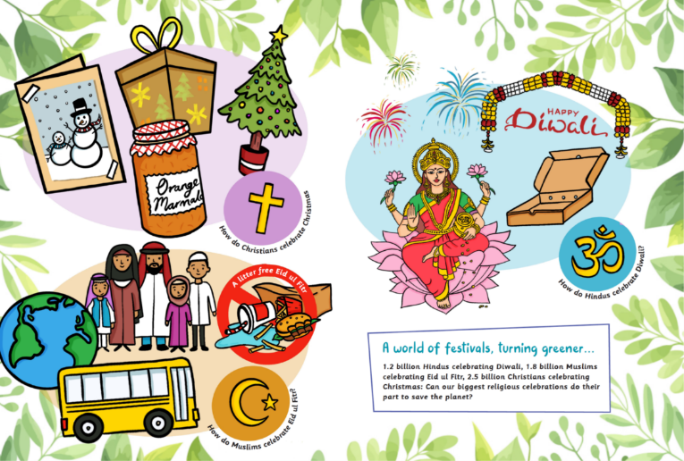
What did you learn?
What could you do?
Can you ‘green your festivals’ like Omar, Priya and Joanna?
BIG QUESTIONS BIG ANSWERS – Investigating worldviews Editor: Fiona Moss © RE Today 2021

Slide 14

NOW IT’S YOUR TURN
You have been tasked with creating a leaflet or poster about ‘greening our festivals’
If you choose to create a poster, you must remember that it should grab the readers attention. It should have a big, bold heading which makes a statement. Information is key and should be to the point. Pictures will also catch the readers attention.
If you choose to create a leaflet, again it should grab the readers attention. Think carefully about the title of your leaflet, what kind of information will you include and who is it meant for? Is it meant for children or is it meant for adults?

